Slide 1
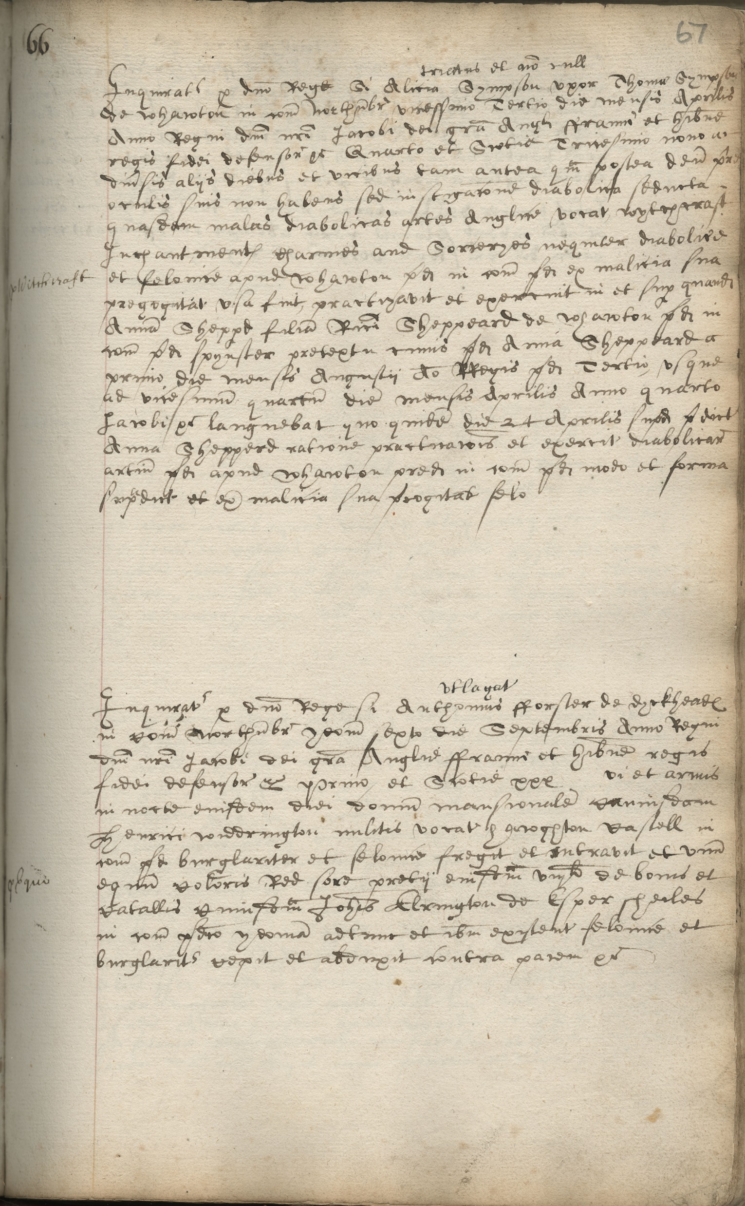


Notes:
This is a page from a book of indictments to the Northumberland Quarter Sessions.
Like virtually all official documents from the time, this document is written in Latin. It is also written a type of script called “Secretary Hand”, which was commonly used during the Early Modern period.
At first glance a document like this can seem almost impossible to read, but with a little bit of practice and a few pointers it isn’t quite so daunting!
CLICK We’ll start off with the margin – the word that has been circled is actually in English, rather than Latin. Scriveners (men whose job it was to write out documents) would often put a word or two in English so that they could easily find what they were looking for.
Go to the next slide to see this enlarged…

Slide 2
Witchcraft
Notes:
Try reading the word (it is in English) before clicking…
CLICK To reveal the transcript.
A transcript is the name used for a text that copies out the writing in an old document – it should be a word-for-word copy. A translation is a text which changes the language of a document – from Latin, for example.
Notice the shape of the letter “c” in the word witchcraft – this is typical of Secretary Hand.

Slide 3
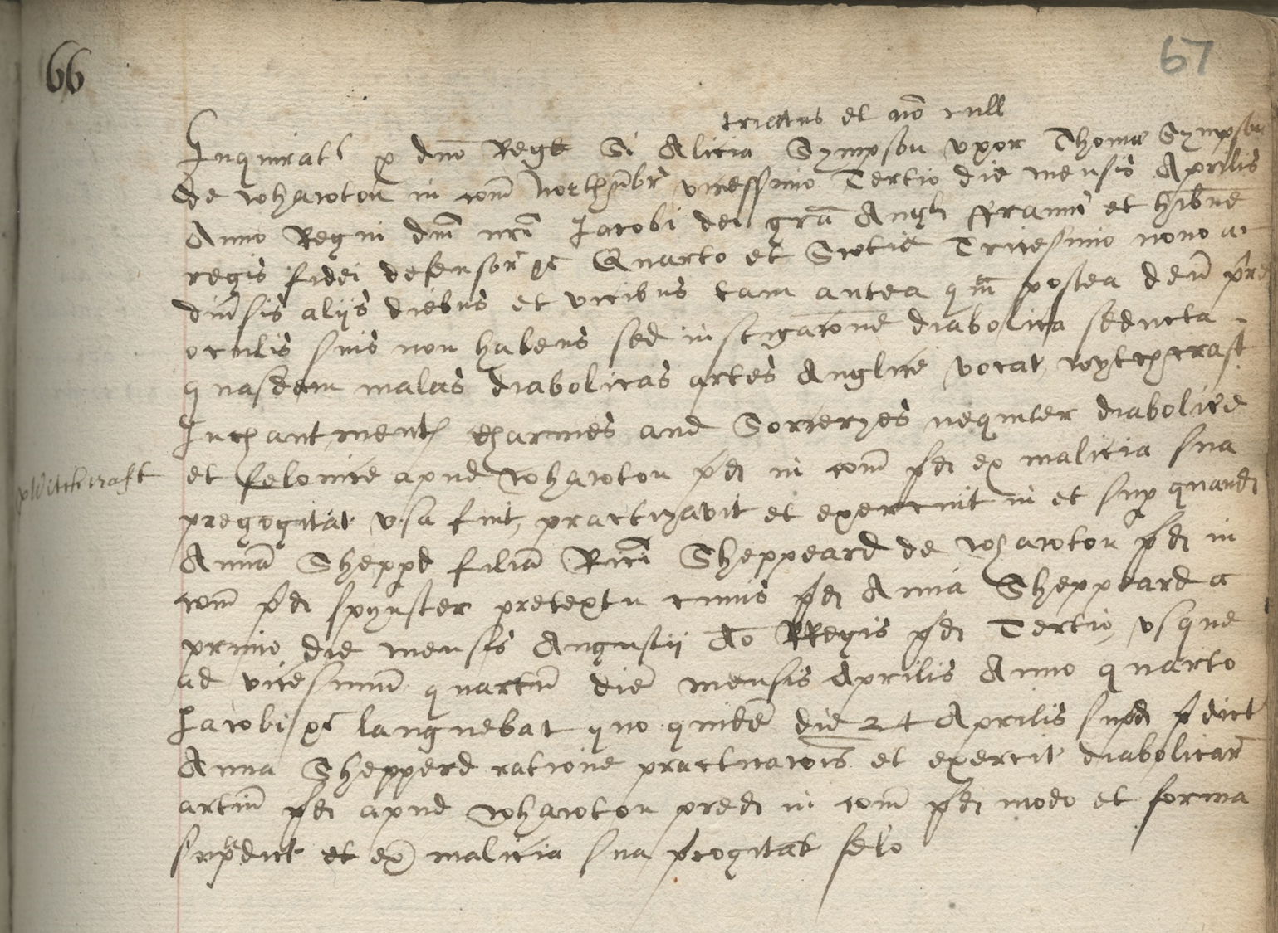
Notes:
CLICK Underlined are the names of the people mentioned in this indictment. The first is the person who has been accused of a crime, the second the person that the crime was committed against…
They appear enlarged on the next slide.

Slide 4


Alicia Sympson uxor Thomas Sympson
Anna Sheppd filia Rici [Ricardi] Sheppeard
Notes:
Try having a go at reading the four names before clicking to reveal the transcripts. Remember the shape of the letter “c” – that is helpful for the first name!
CLICK To reveal the transcript.
The trickiest letter shapes here are the letter “s” in the middle of a word (as Sympson) – it has a long shape that often starts above and finishes below the line of the other lower case letters. It looks a little bit like an “f” without the cross stroke.
Also have a look at the letter “e” in the middle of words. This is often confused with the letter “o”, but the “e” has the curl at the top – compare “o” in “uxor” and “e” in “Sheppeard”.
It is also worth noting the abbreviations here – this is very usual in documents of this time. Anna’s surname has been shortened to “Sheppd” but appears in the longer form “Sheppeard” in other places. Richard appears as “Rici” – the squiggle over the top of the name shows that it has been abbreviated.
CLICK The two circled words show the relationship to Alicia and Anna to the two men:
uxor = wife of
filia = daughter of
If they are unmarried, women will often be mentioned with their father and with their husband if they are married. Widows might appear with the name of their dead husband. Men are usually defined by their status or their job.

Slide 5
Notes:
CLICK These two lines are pretty interesting. They summarise the charge against Alicia.
See next slide for this text enlarged…

Slide 6
Anglicane vocat – is called in English
wythchcraft
Inchantmentes Charmes and Sorceryes
Notes:
CLICK The phrase that appears here “Anglice vocat” (literally English calls) means that the next part will be in English.
CLICK To see next part of the text – the bit in English.
Have a go at reading these five words before clicking for the transcript.
CLICK x 2 for transcripts
Where two letters are written together in one movement, they can look quite different to the two letters written separately. Where two letters are linked together in this way it is known as a “ligature”. Notice the lower case “ch” ligatures in witchcraft and Inchantmentes – these are typical. In “Charmes” the ligature is with a capital “c”. The “h” in these cases has a tail which descends below the line (like a “g”, “y” or “p”). This is typical for Secretary Hand.

Slide 7
Notes:
CLICK Highlighted are the place names mentioned in the text. As you can see, the same place name is mentioned in several places. There are no other places recorded here – both Alicia and Anna were from the same village.
On the next slide the first highlighted section can be seen in detail.

Slide 8



de Whawton in com northubr
comitatus - county
Northumbria – Northumberland
of Whalton
Notes:
CLICK This is a transcript of the highlighted section. This is how it appears letter for letter.
CLICK All of the people mentioned in the indictment are “of Whawton” – they live in the village of Whalton. Notice that the spelling of the place name has changed. Many place names have had several variations – often one letter or sound changes.
CLICK The “m” of “com” has been flicked up over the word – this is sign that the word has been abbreviated. The same is the case over the “u” in “northumbr”.
CLICK

Slide 9
Notes:
The date of this indictment has been split into two parts.
CLICK This is the first part – an enlargement of it is on the next slide.

Slide 10



vicessemo Tertio die mensis Aprilis
twenty-third
day month of
April
Notes:
This is the part of the date that includes the day and the month.
CLICK This is a transcript of what appears in the document.
CLICK Can you guess what this word might translate as? – It is very similar to the English! CLICK to reveal.
CLICK – As this is the date – what do you think that this part might be? CLICK to reveal.
Can you guess what the other two words might mean? Hint – the begin with the same letters in English. CLICK to reveal.

Slide 11
Notes:
CLICK
This section contains the information about the year of this document.
The next slides breaks it down.

Slide 12

Anno Regni
= year of the reign
Anno Domini
Jacobi
= James
Notes:
CLICK to reveal transcript.
This two word phrase indicates how the year is calculated in this document.
CLICK to reveal translations into English. Like most medieval and early modern documents the year is not calculated as we would today.
CLICK to reveal “Anno Domini” and CLICK again for this to be crossed through!
The number that we give to the year (2021) is Anno Domini – AD 2021, The Year of Our Lord 2021 – the number of years since the birth of Christ. (Now also referred to as 2021 CE or Common Era).
Use of AD dates wasn’t very common at this point in history– very often years would be measured according to the length of the reign of the monarch (regnal years). Papal documents used the length of time the pope was on the throne of Saint Peter. Documents created by a bishop or archbishop might use the length of time the incumbent had been in charge of the diocese/archbishopric.
CLICK to reveal name of the king from the document. To work out what AD year this document was created in we need to know which monarch ruled Britain at the time.
CLICK to reveal transcript. CLICK again to reveal translation.
Note – historians and archivists often use C R Cheney “A Handbook of Dates” to translate regnal/papal years. This book includes handy tables!

Slide 13







Quarto
et Scotia
Tricessimo nono
fourth [year]
and Scotland
thiry-ninth [year]
Notes:
This is the part of the document where we find the regnal year of James – and so we can work out the AD year.
There is a formulaic phrase between James’s name and the number here – it basically says James by the grace of God King of England, France and Ireland… This is used in a very similar form in most official documents.
CLICK to show number circled. CLICK again for transcript and CLICK again for translation.
So we know that this was created in the fourth year of James I’s reign. James ascended to the English throne on 24 March 1603, dating this document to 1606.
But, there is an extra bit here! CLICK to show transcript of next two words. CLICK again for translation.
James I was also James VI of Scotland! His regnal year for the Scottish throne is also included.
CLICK for number to be circled. CLICK for transcript. CLICK for translation.
James ascended to the Scottish throne on 24 July 1567, so his English and Scottish regnal years started on different days.

Slide 14
What we did… | What have we learnt…?
Handwriting | Palaeography (technical name for reading old handwriting) Secretary Hand (there are others – Court Hand, Italic…) Started to understand and read letter shapes Practice makes this easier – online tutorials
Dating documents | Different way of calculating years Regnal years
Latin | Don’t let it put you off! Don’t need to do a complete word for word translation Learning a few words means that you can often extract meaning
Form of documents | Diplomatic – technical name The order that information appears on the page tells us a lot – which names are first? English note in the margin
Notes:
Cambridge University online palaeography: https://www.english.cam.ac.uk/ceres/ehoc/
The National Archives online palaeography: https://www.nationalarchives.gov.uk/palaeography/
Beinecke Library, Yale University, online Secretary Hand tutorial: https://beinecke.library.yale.edu/article/quarantine-reading-learn-read-secretary-hand
Scottish Handwriting online tutorials: https://www.scottishhandwriting.com/index.asp
National Archives Latin tutorial: http://www.nationalarchives.gov.uk/latin/
Family Search list of Latin vocabulary for family history (includes numbers, month, days of the week): https://www.familysearch.org/wiki/en/Latin_Genealogical_Word_List

