Slide 1
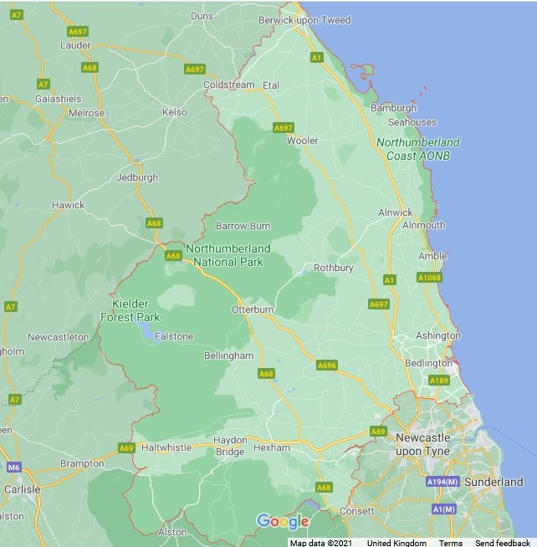

John English and Robert Mantua, baptised Bamburgh 1784 (Madras)
John London, baptised Norham 1763
George Sylla, baptised Carham 1767
Charles Reed, baptised Eglingham 1778
John Crow baptised Chatton 1768
Snowball Stavers, baptised Woodhorn 1821
William Mungo, baptised Woodhorn 1788
Malcom Patterson, wife buried Earsdon 1780
William Wandoe, baptised 1714, buried 1716, Hexham
Peter and Samuel Blyth, baptised Earsdon 1798
Blackett Shaftoe, baptised Ovingham 1788

