Slide 1

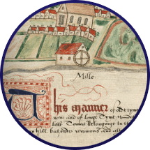


What are manorial Documents?

Slide 2
Manorial Documents
Documents and records that tell the story of each manor and the people who were part of it. This could include:
The names of jurors
The cases heard at the court and the outcome of each case
Information about the land/property that formed the manor
The names of tenants
The rules and customs of the manor
Someone being accused of breaking a custom of the manor

Slide 3
Manorial Documents
5 minutes per document:
What type of document is it?
When is it from?
Which Northumbrian Manor is it from?
What does it show or tell us?

Slide 4
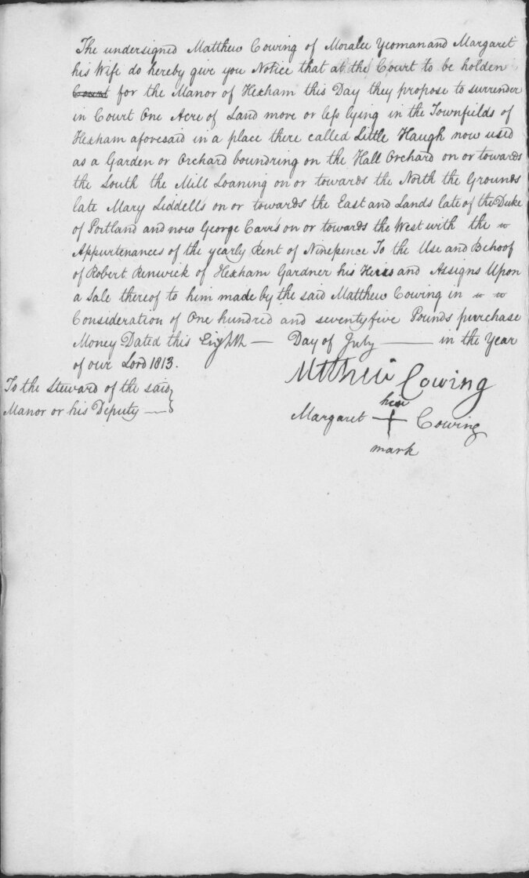
Manorial Documents
What type of document is it?
Surrender and admission
When is it from?
8 July 1813
Where is it from?
Manor of Hexham
What information does it give us?
One tenant giving up manorial land and another tenant taking it over
NRO 0672/A/9/2/2

Slide 5
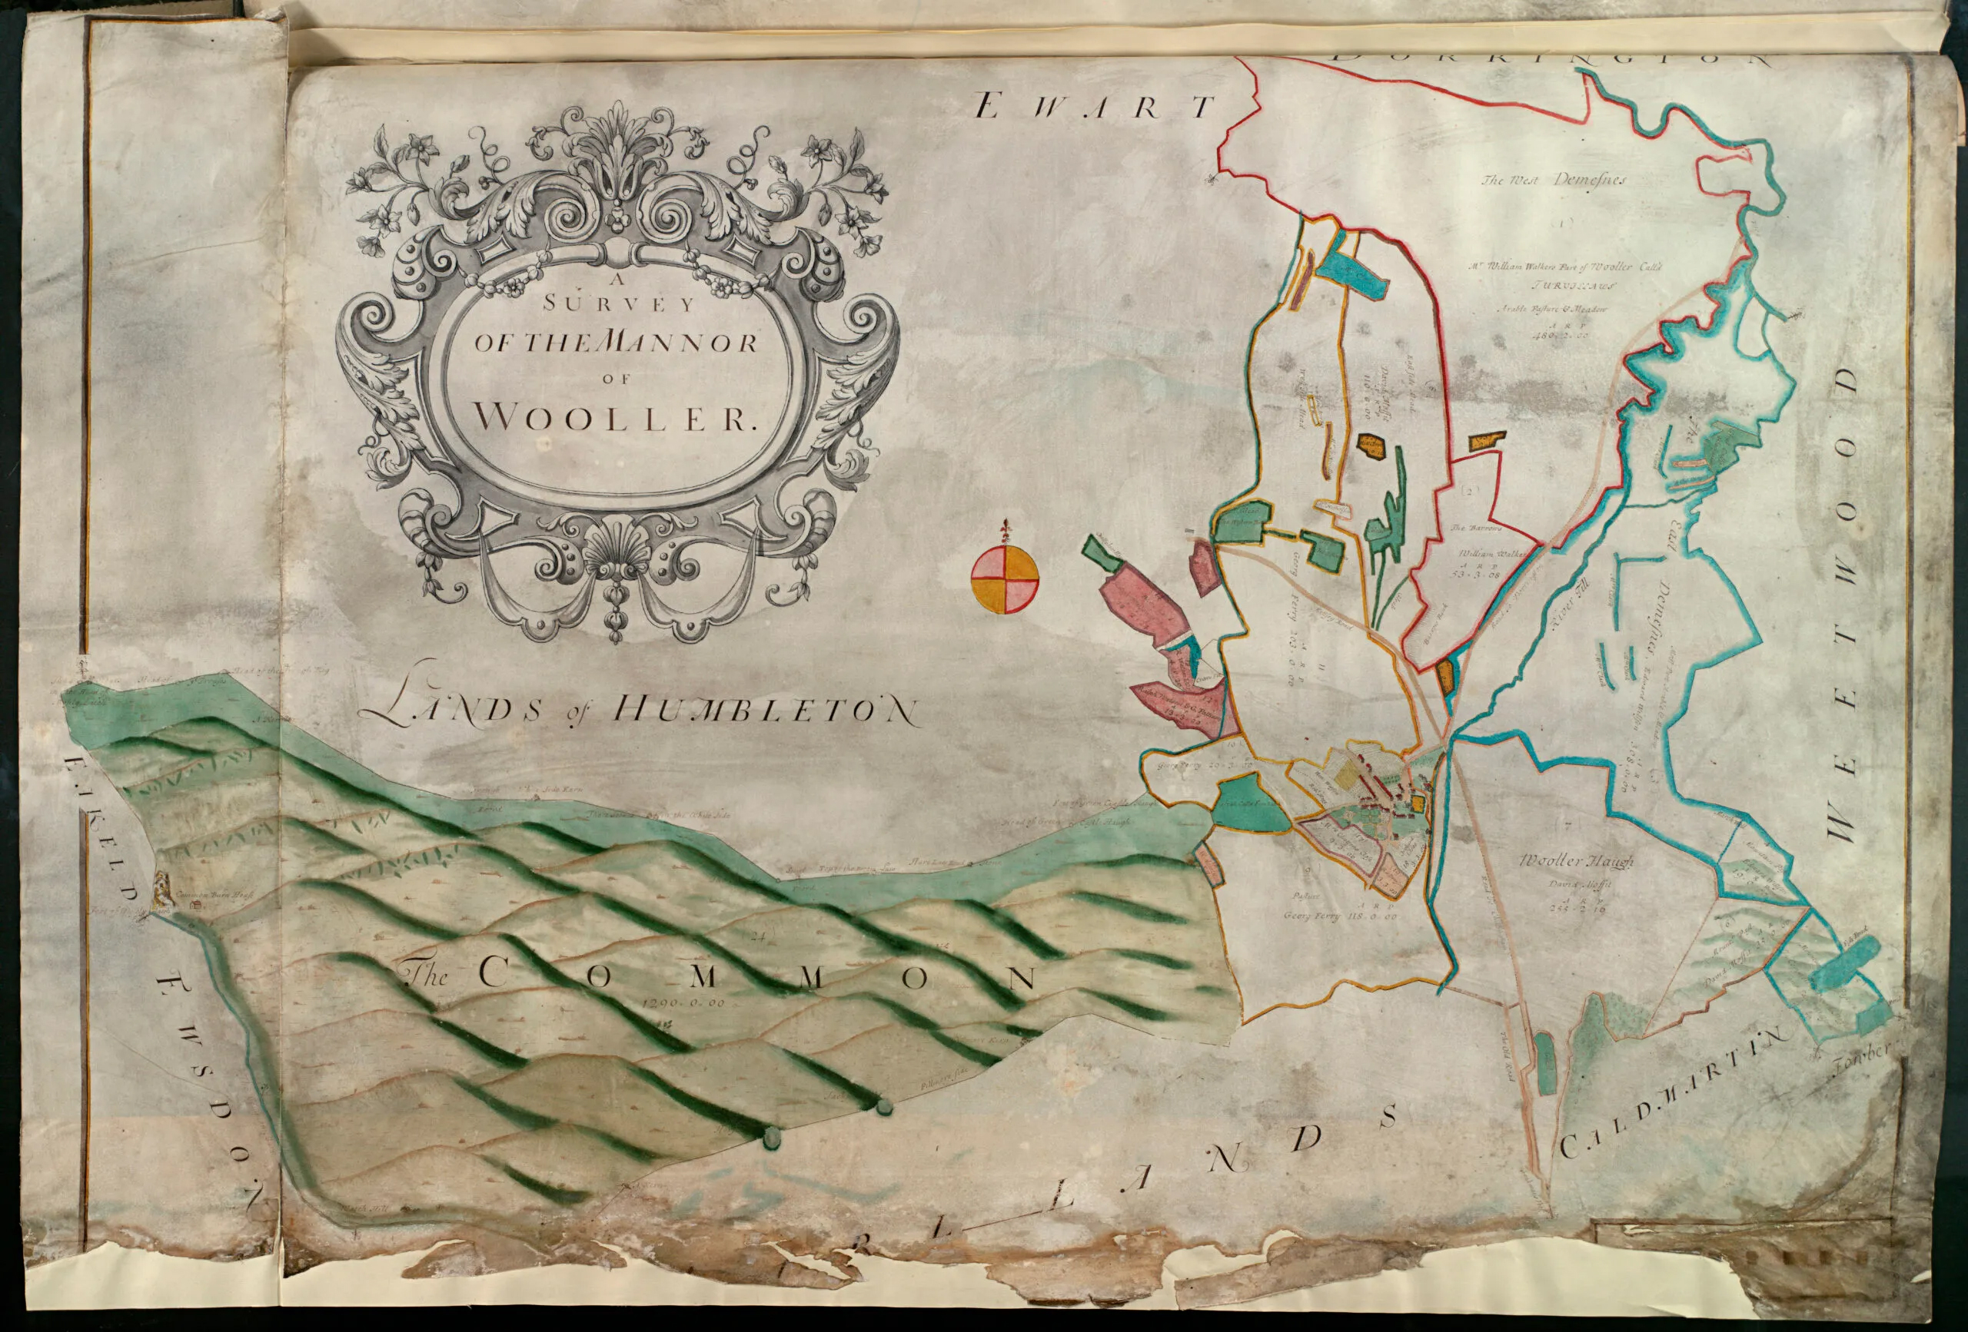
Manorial Documents
What type of document is it?
Survey
When is it from?
1711
Where is it from?
Manor of Wooler
What information does it give us?
Shows us the land included in the manor and the names of tenants
NRO 04206/f.21

Slide 6
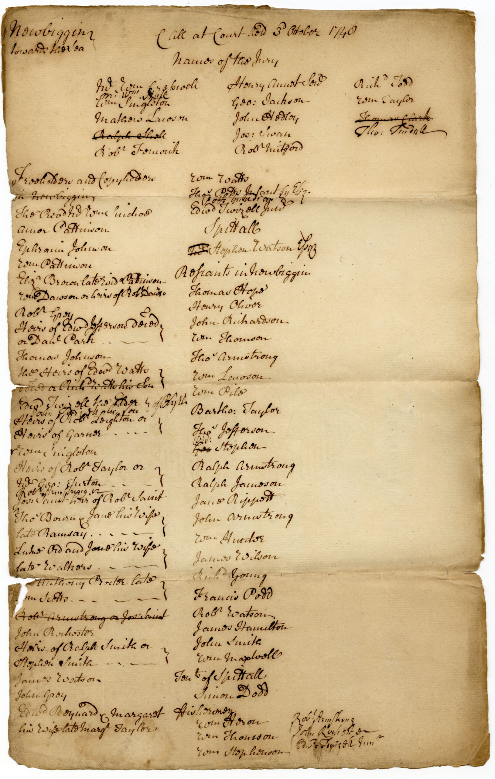
Manorial Documents
What type of document is it?
Call roll
When is it from?
3 October 1748
Where is it from?
Newbiggin by the Sea
What information does it give us?
A list of tenants expected to attend the manor court
NRO 0691/49/A/2/3/6

Slide 7
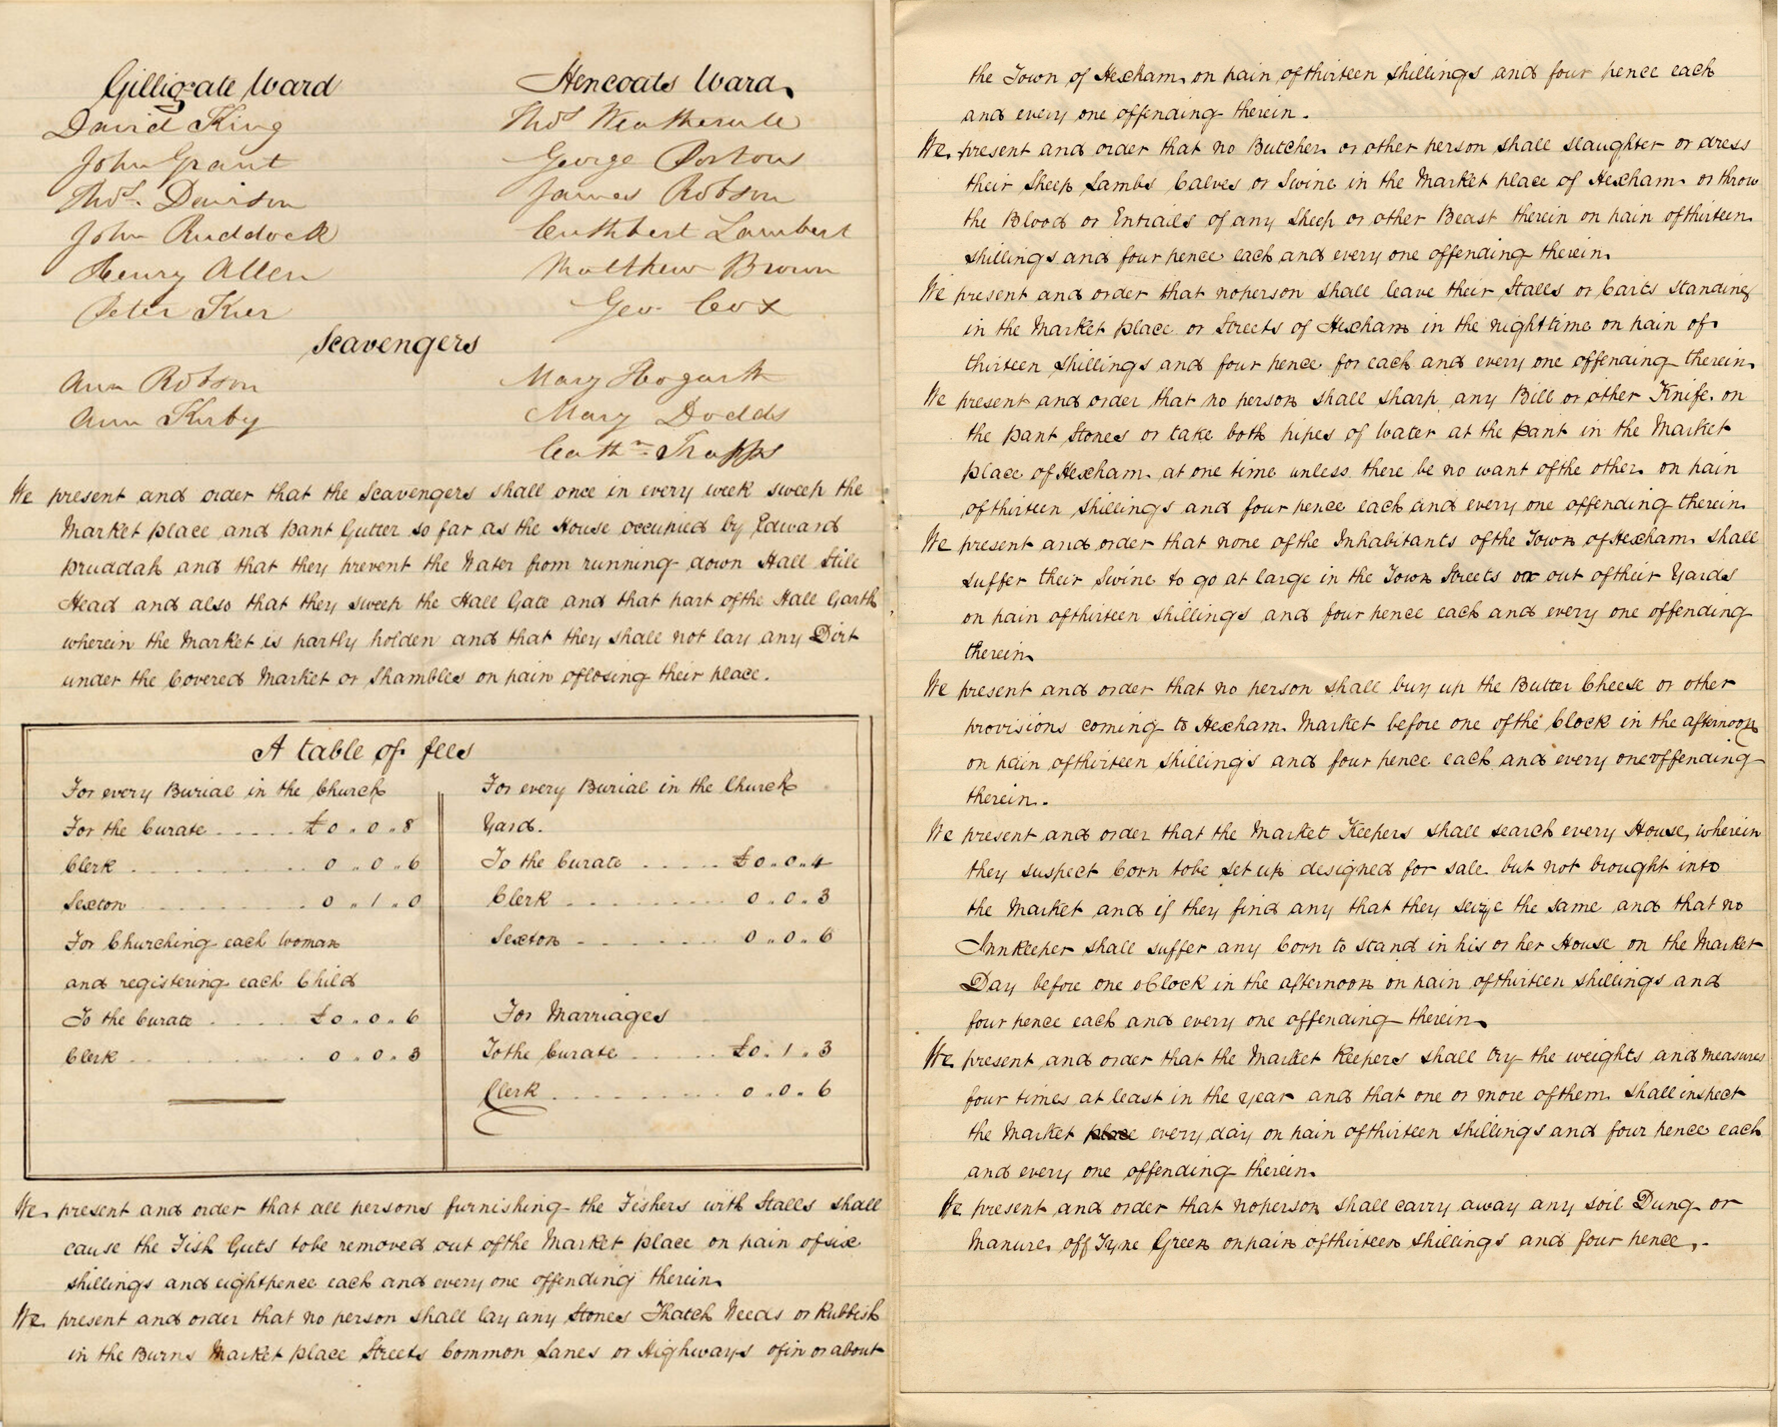
Manorial Documents
What type of document is it?
Borough book – rules and customs
When is it from?
1840
Where is it from?
Manor of Hexham
What information does it give us?
Rules and customs of the Manor of Hexham
NRO 0672/A/3/105/1

Slide 8
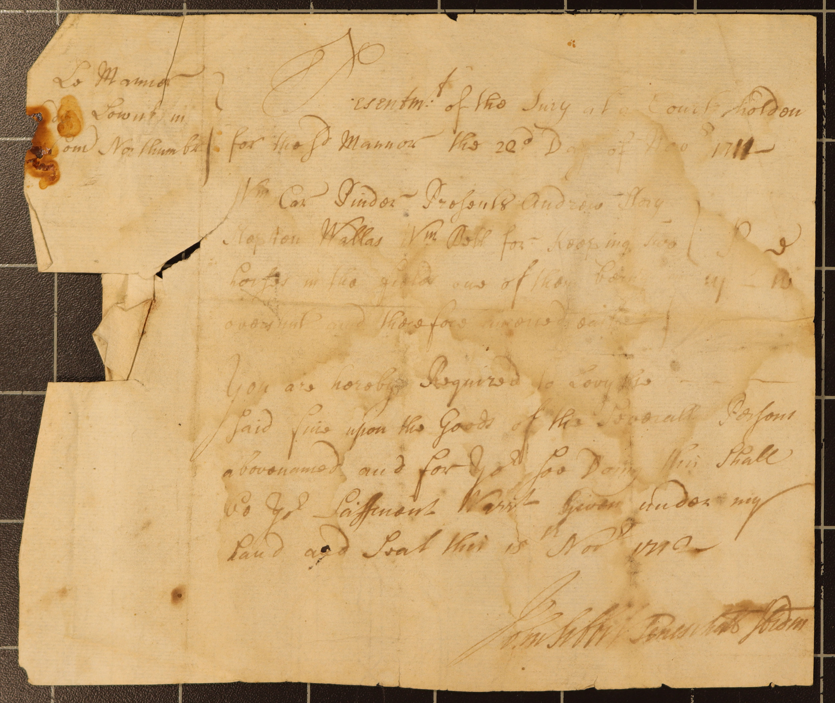
Manorial Documents
What type of document is it?
Presentment
When is it from?
22 Nov 1711
Where is it from?
Manor of Lowick
What information does it give us?
A statement accusing someone of breaking the rules of the manor
BRO 331/A/1/2/1

