Slide 1

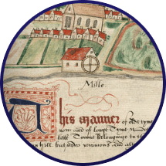


In the Manor

Slide 2
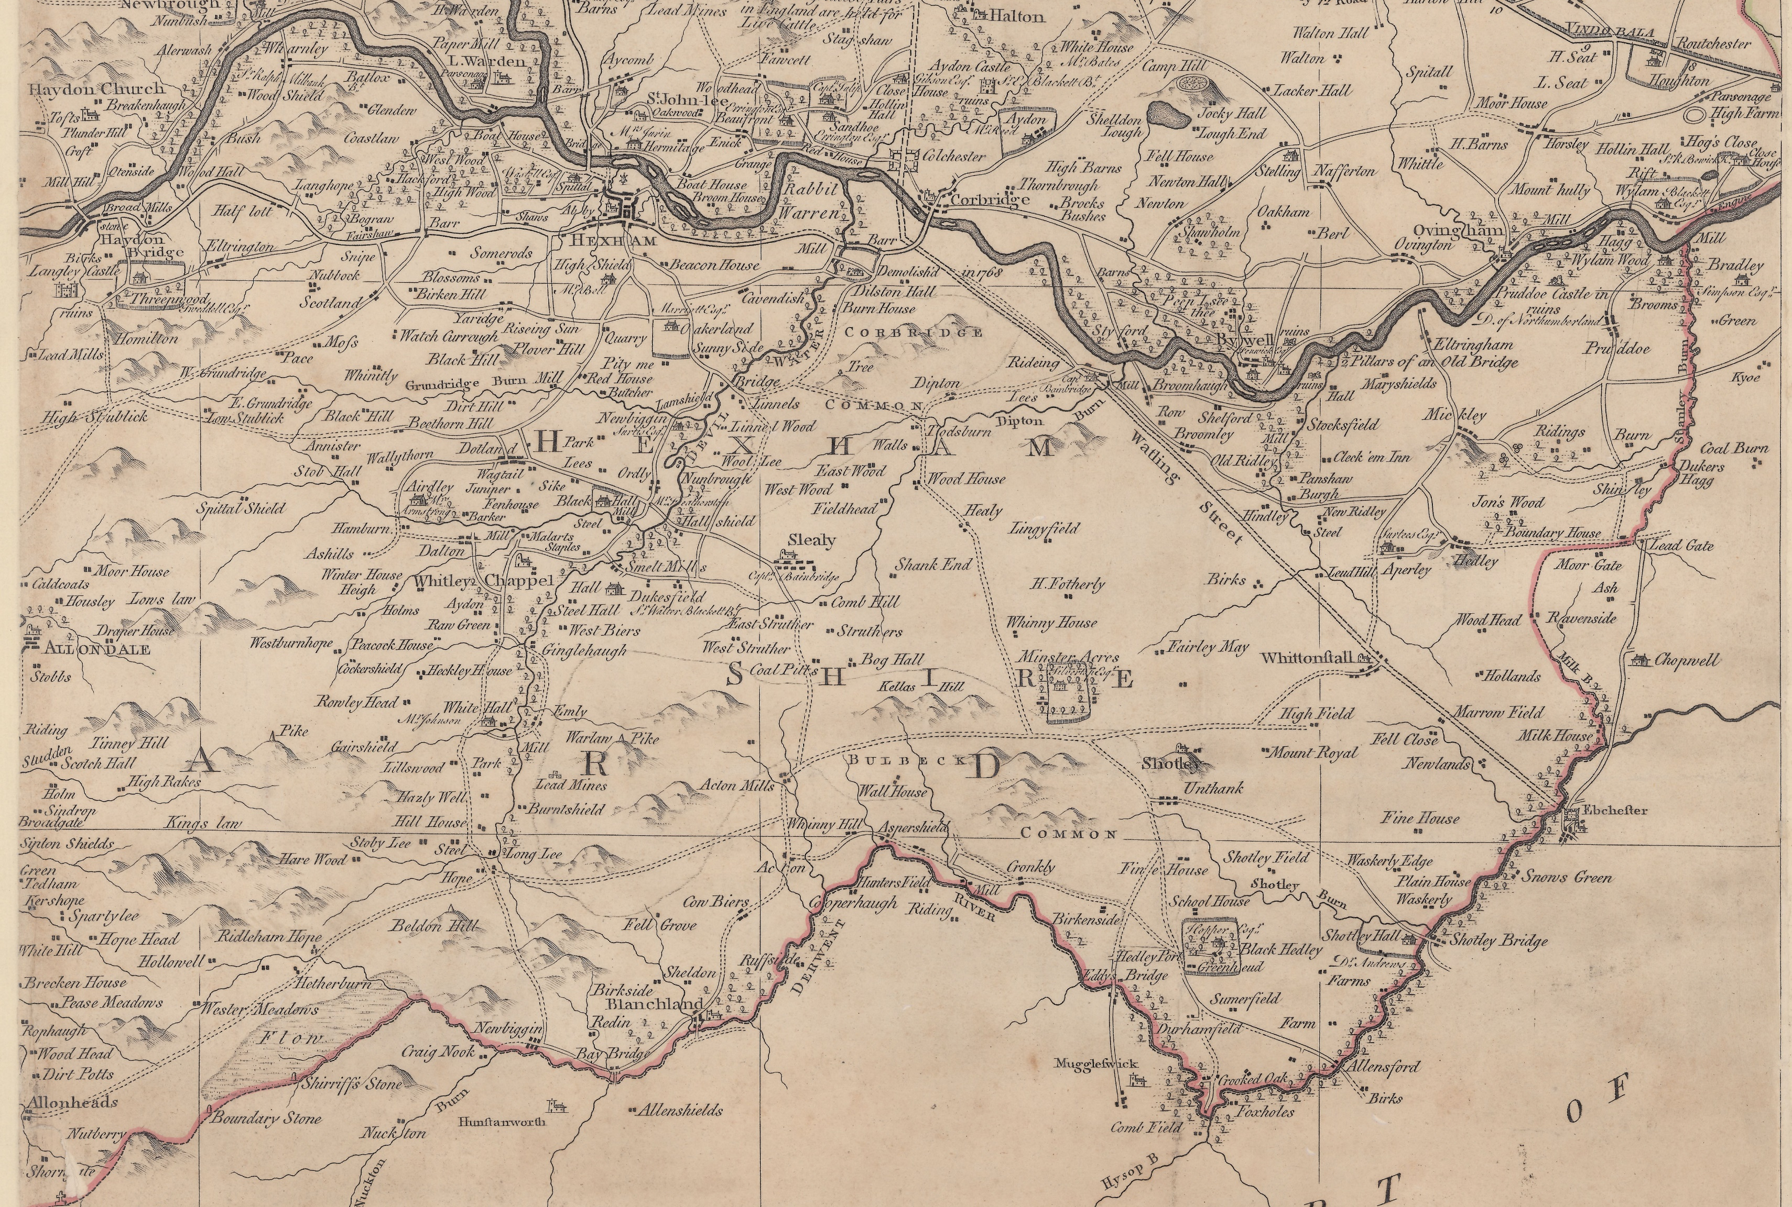
What buildings and landmarks were in the Manor?
In pairs, spend 5 minutes looking at the map. Make note of all the buildings you can see.
Make a class list of all of the buildings identified on the map

Slide 3
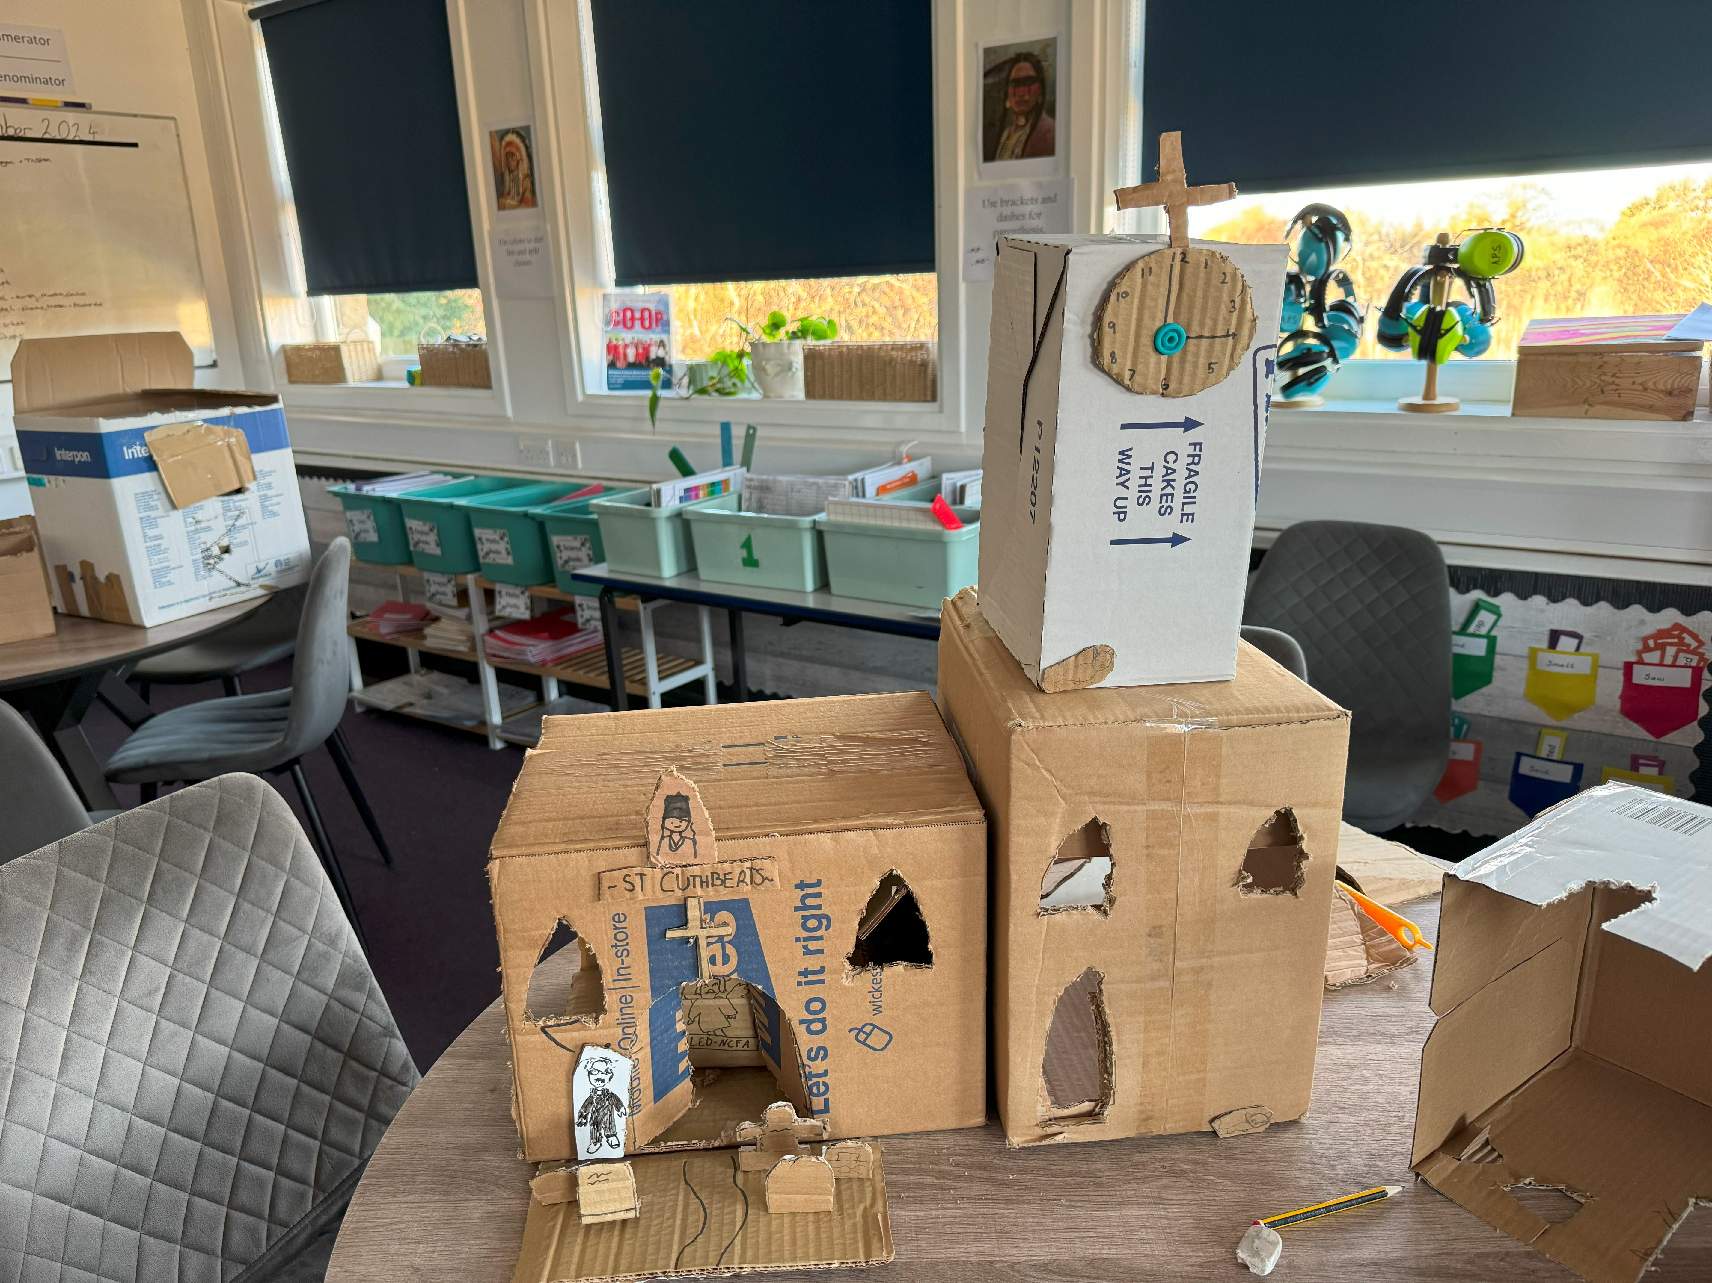
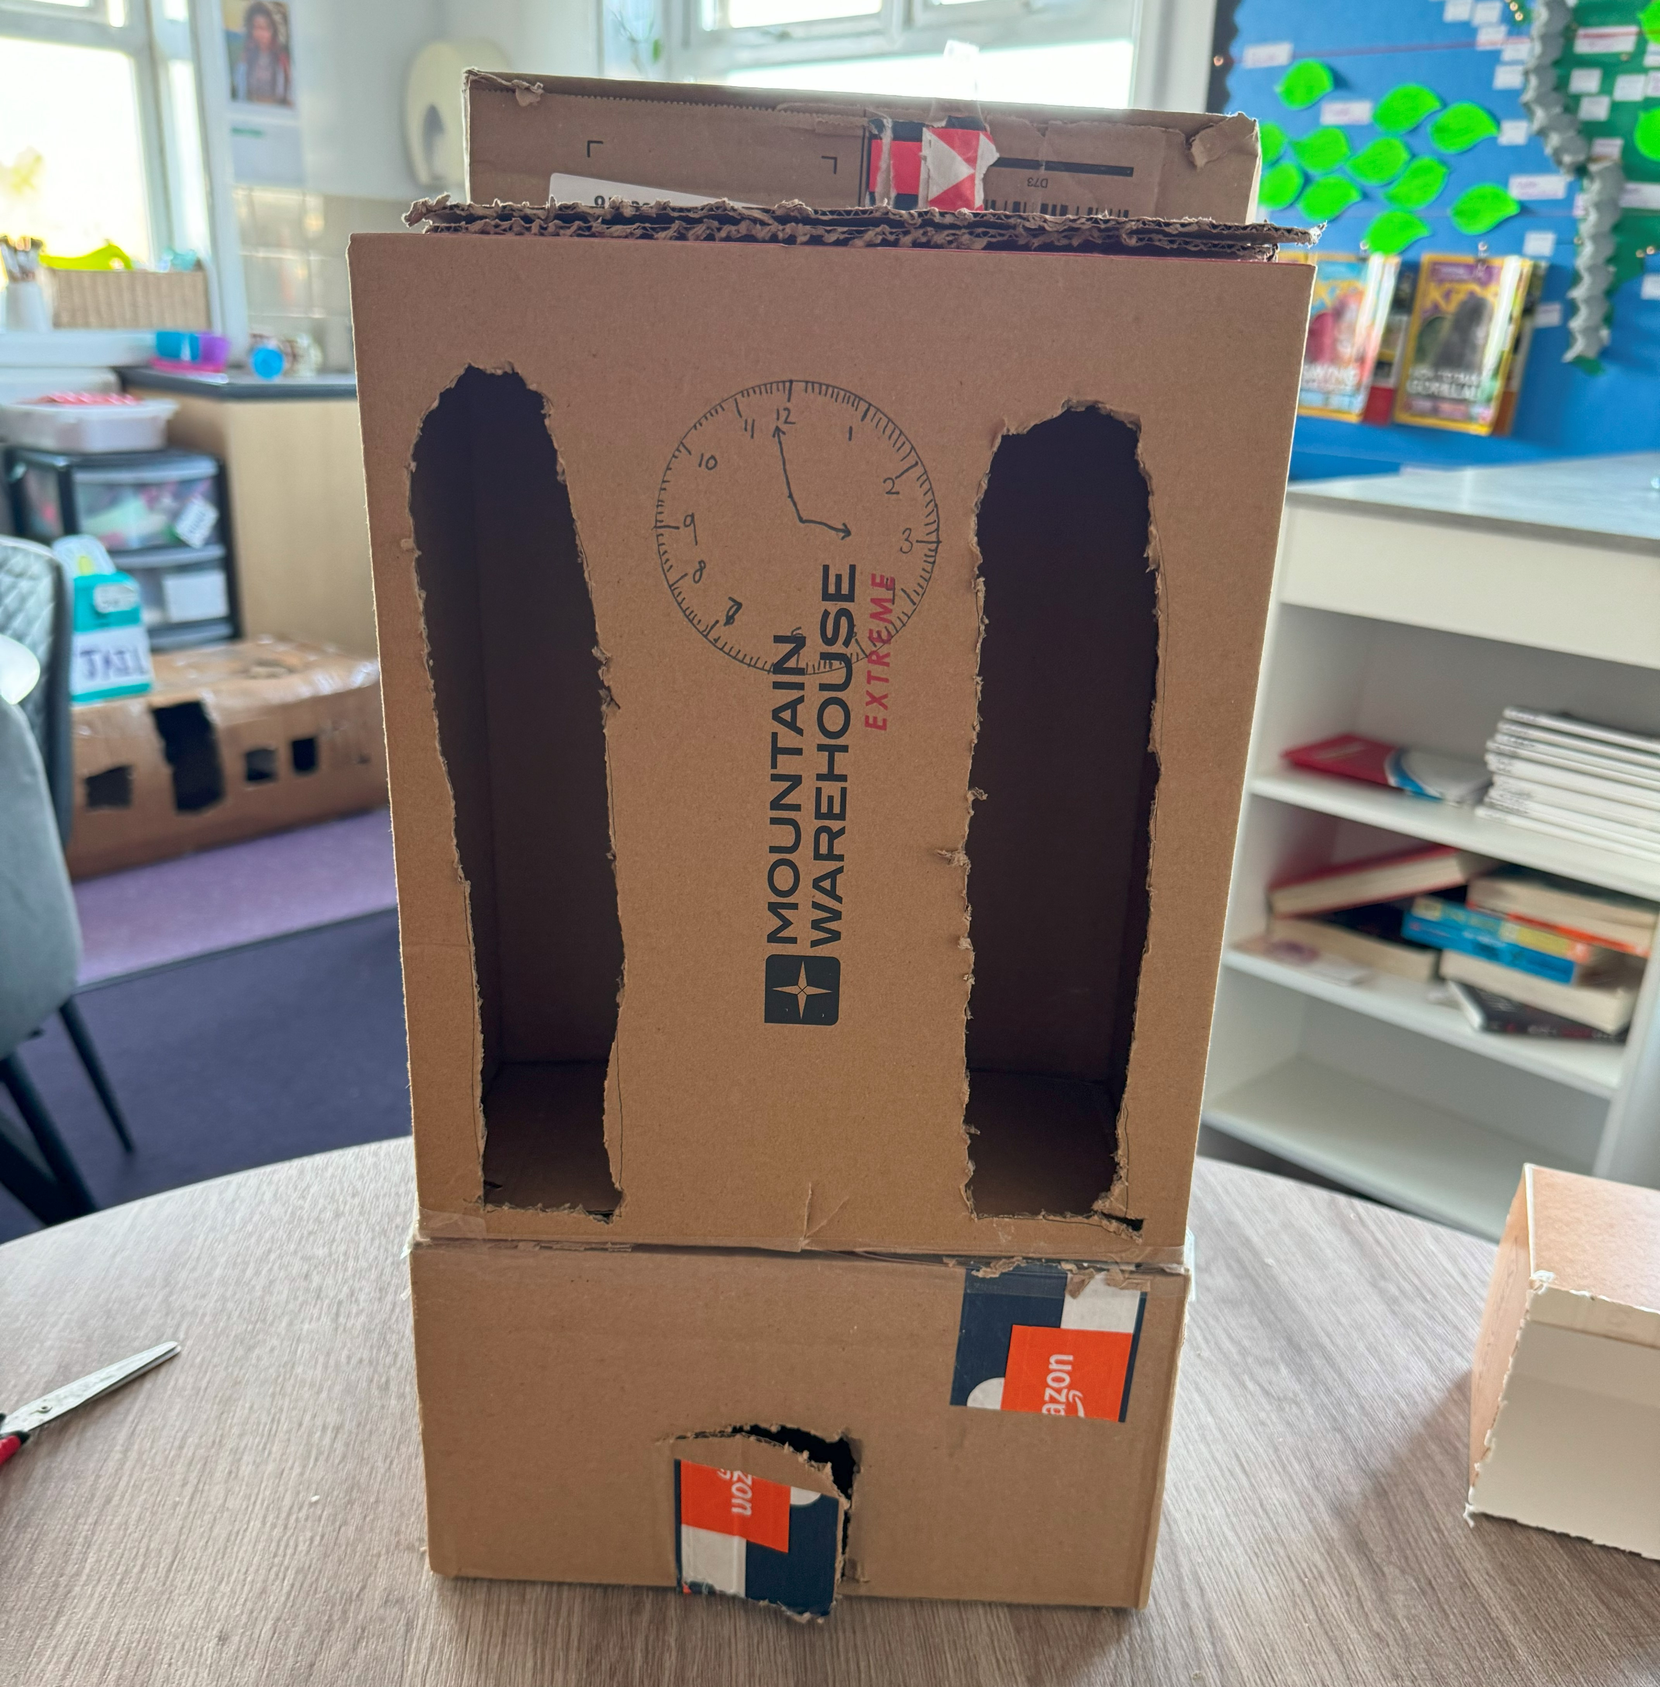
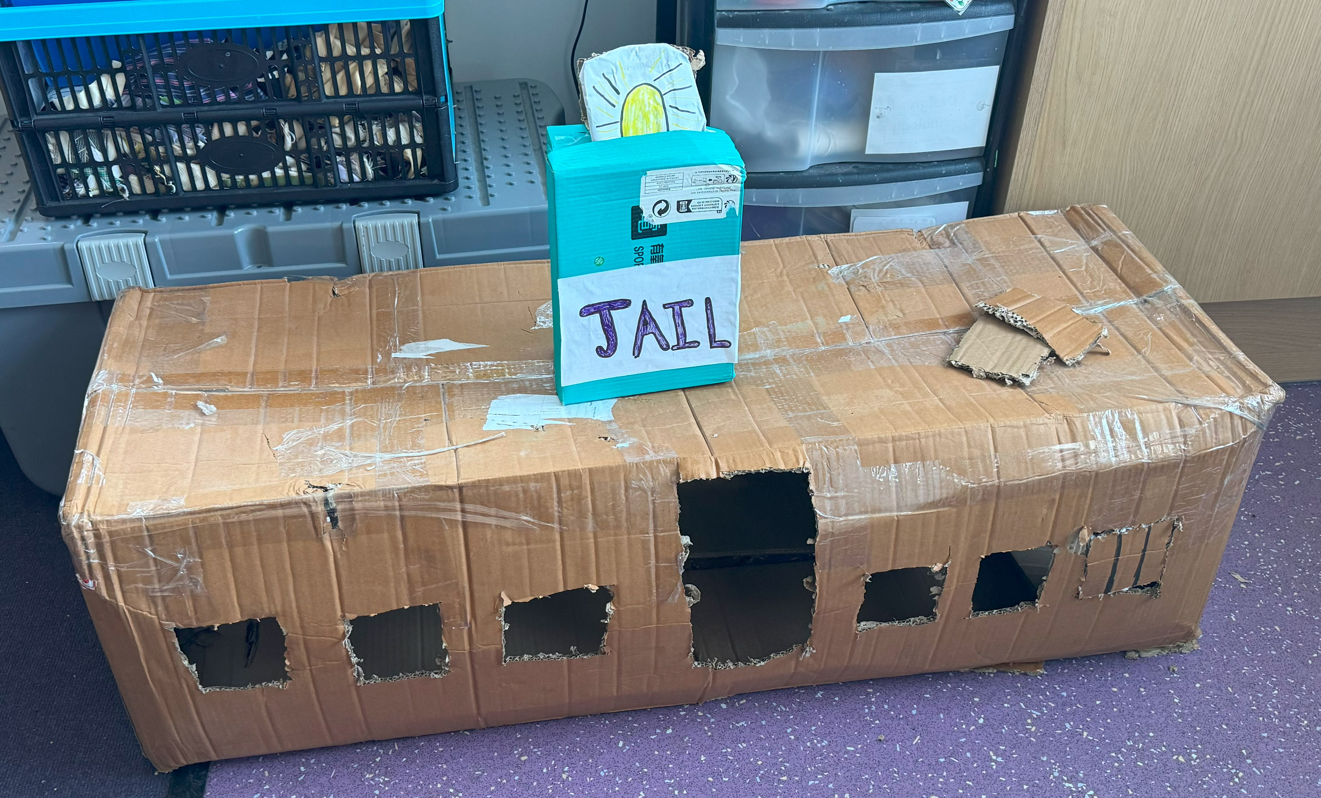
Building the Manor
In pairs – choose a building from the class list
Construct your chosen building
Put all of the buildings together to form a manor

