Slide 1

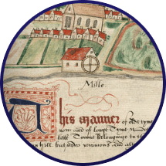


In the Marketplace

Slide 2
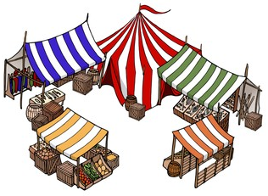
Why were markets important?
Farmers sell their crops and goods
Trade with people from other areas
Brought money into the manor

Slide 3


Oral History
How many people are speaking?
Can you hear the name of any places that you know? Are there any words that you don’t know?
What is being described in this interview?
What does it tell us about the market?

Slide 4
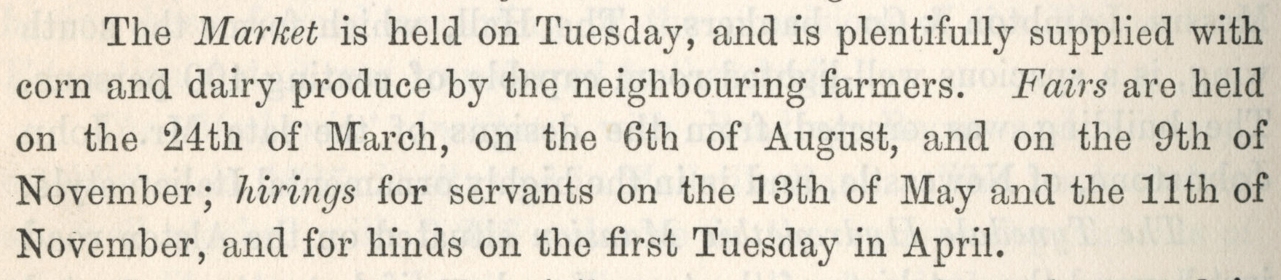
Marketplace Documents
5 minutes per document:
What does it show or tell us?
Bulmer’s Directory, 1886 p340 - Hexham

Slide 5
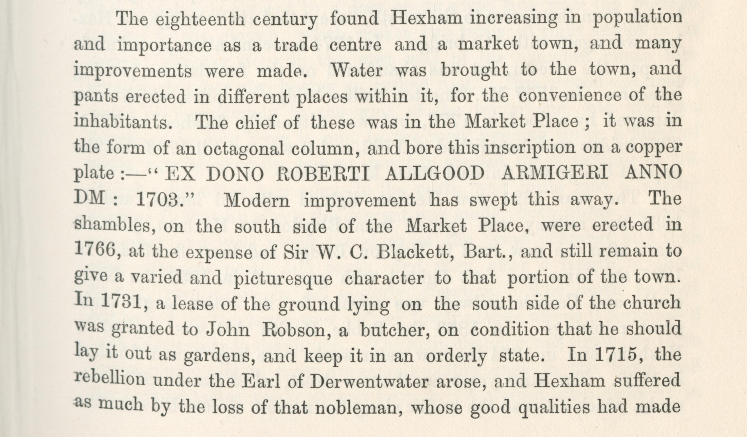
Marketplace Documents
Bulmer’s Directory, 1886 p301 - Hexham

Slide 6
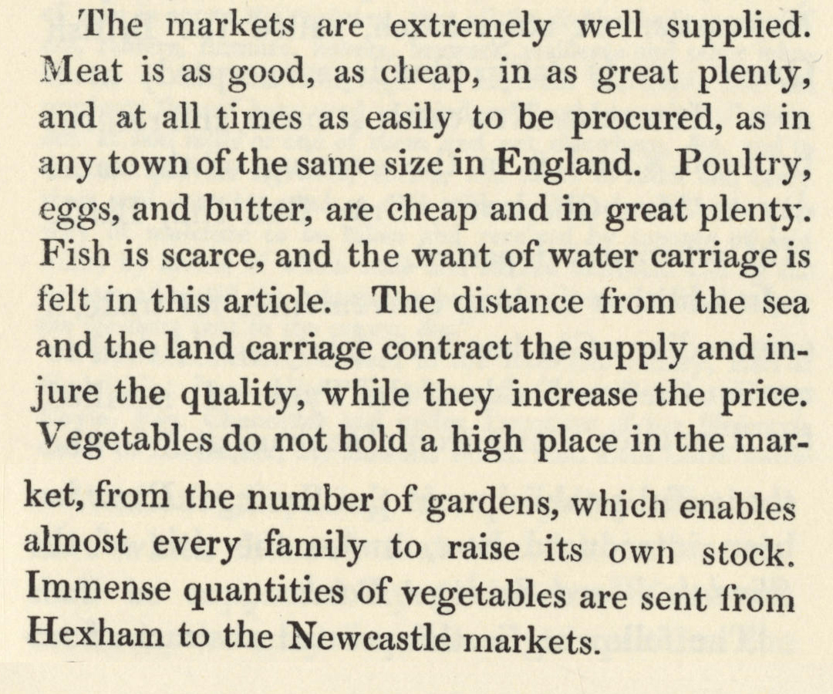
Marketplace Documents
History of Hexham – A B Wright, 1823 p30

Slide 7
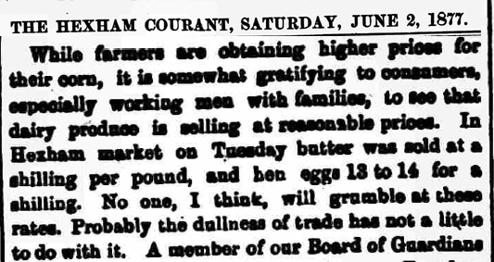
Marketplace Documents
Hexham Courant – 2 June 1877

Slide 8
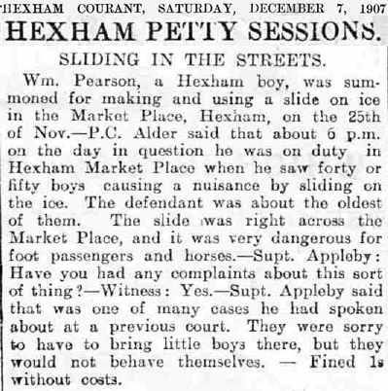
Marketplace Documents
Hexham Courant – 7 December 1907

Slide 9
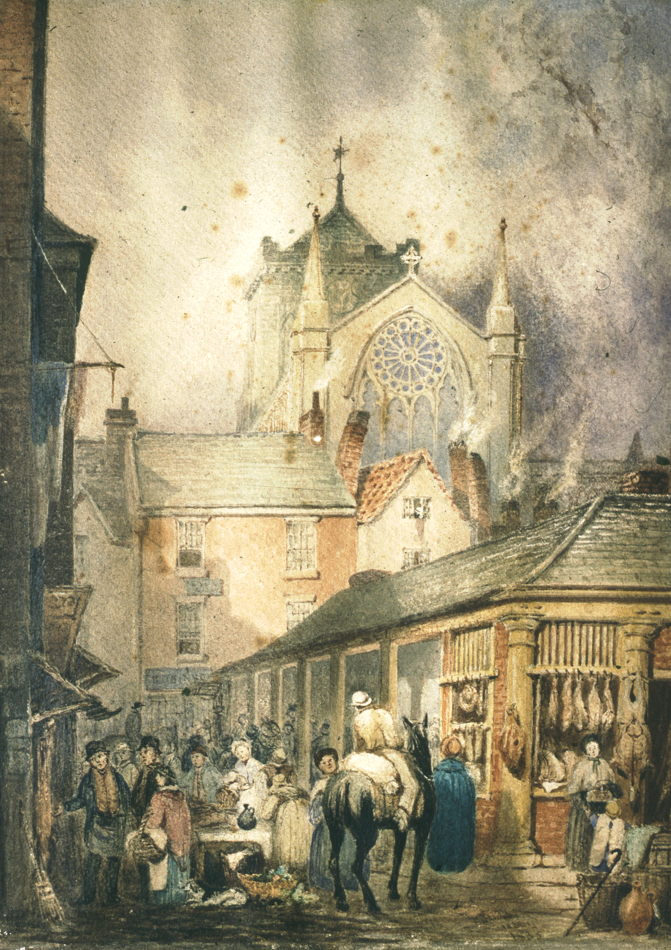
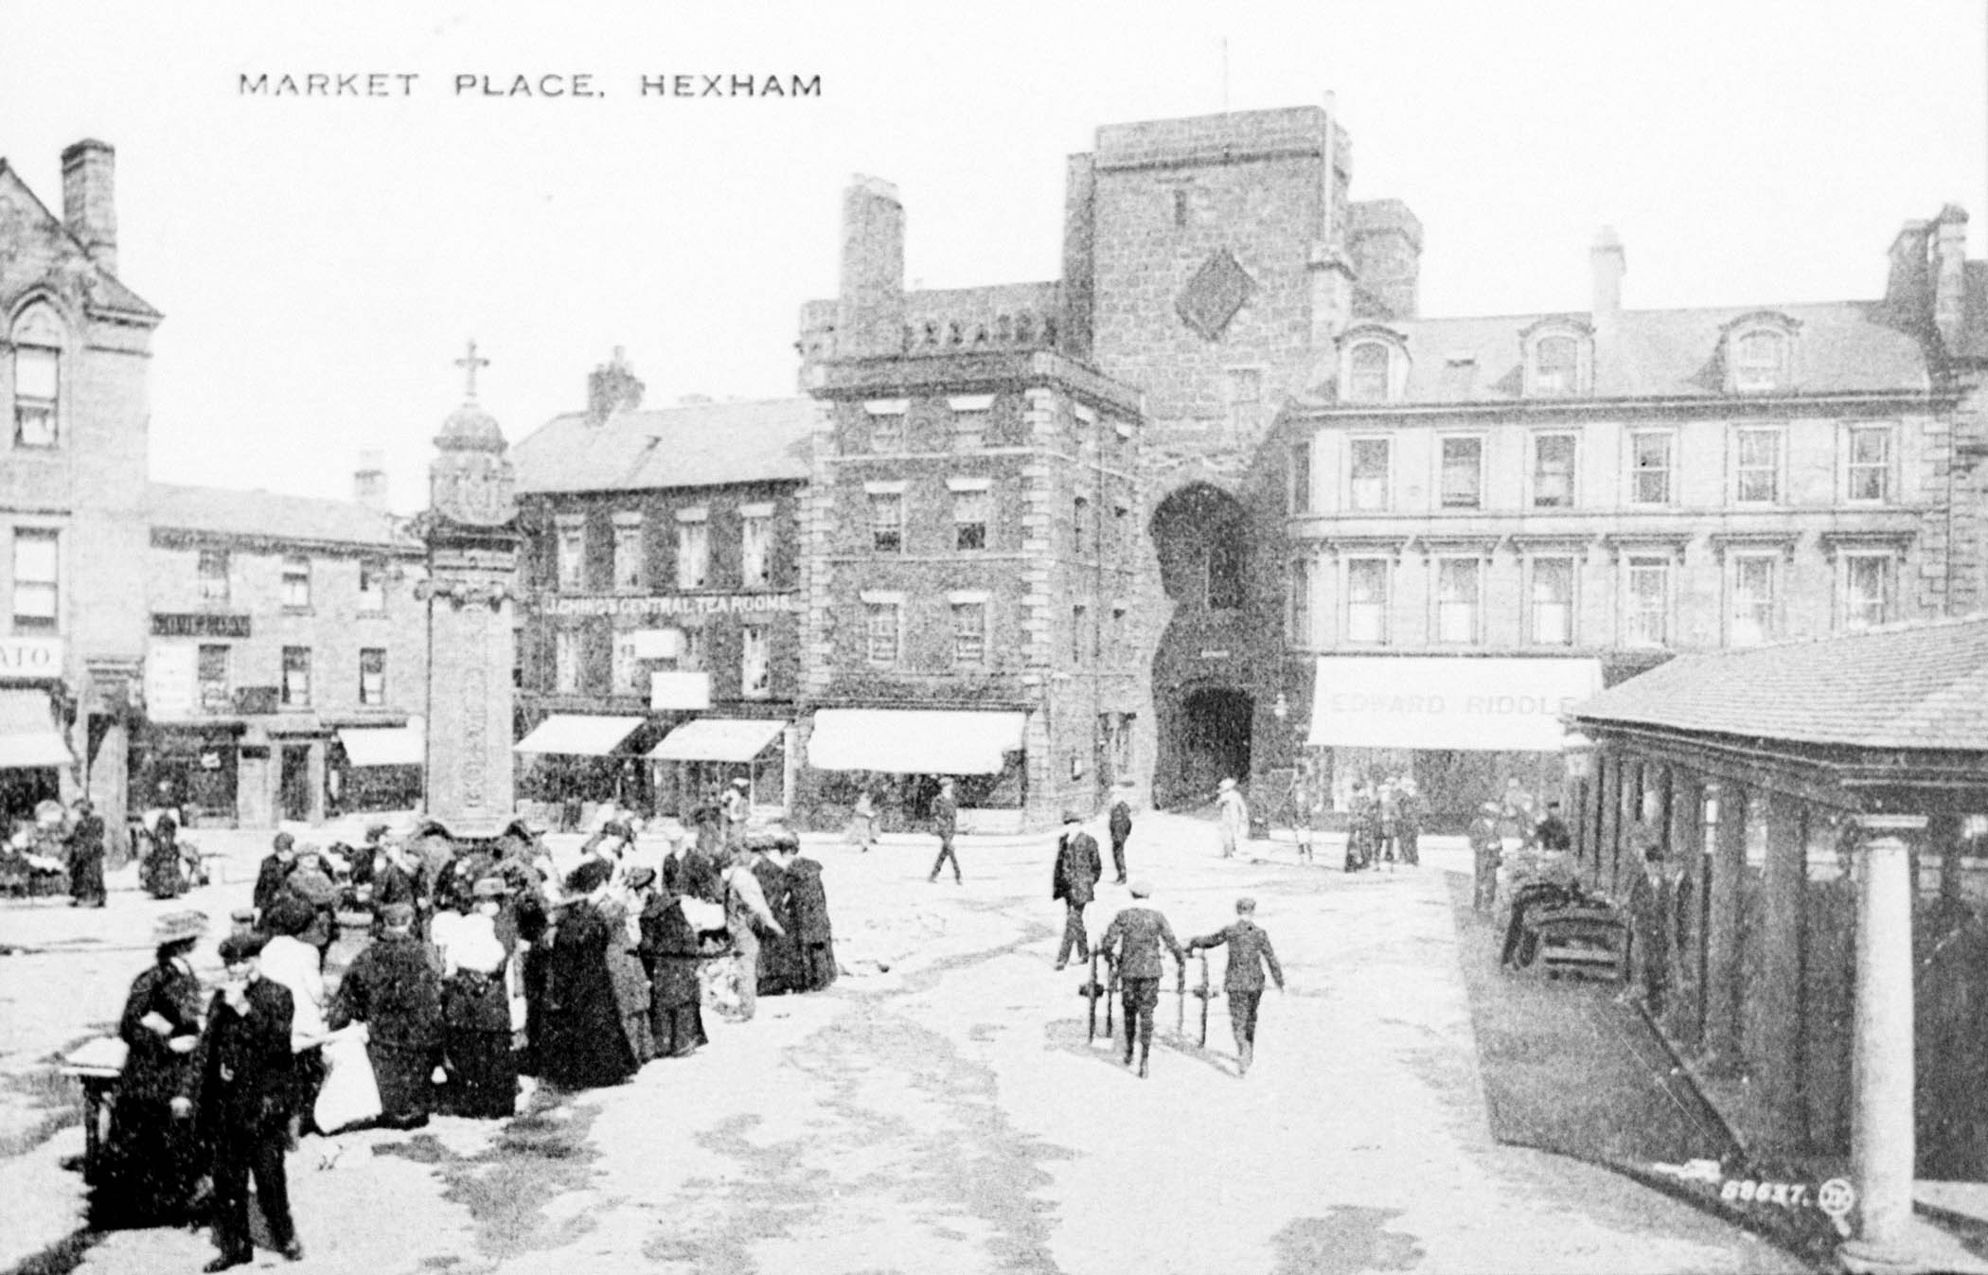
How have marketplaces changed?
NRO 01542/33
NRO 05845/3/12

