Slide 1

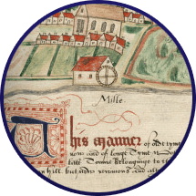
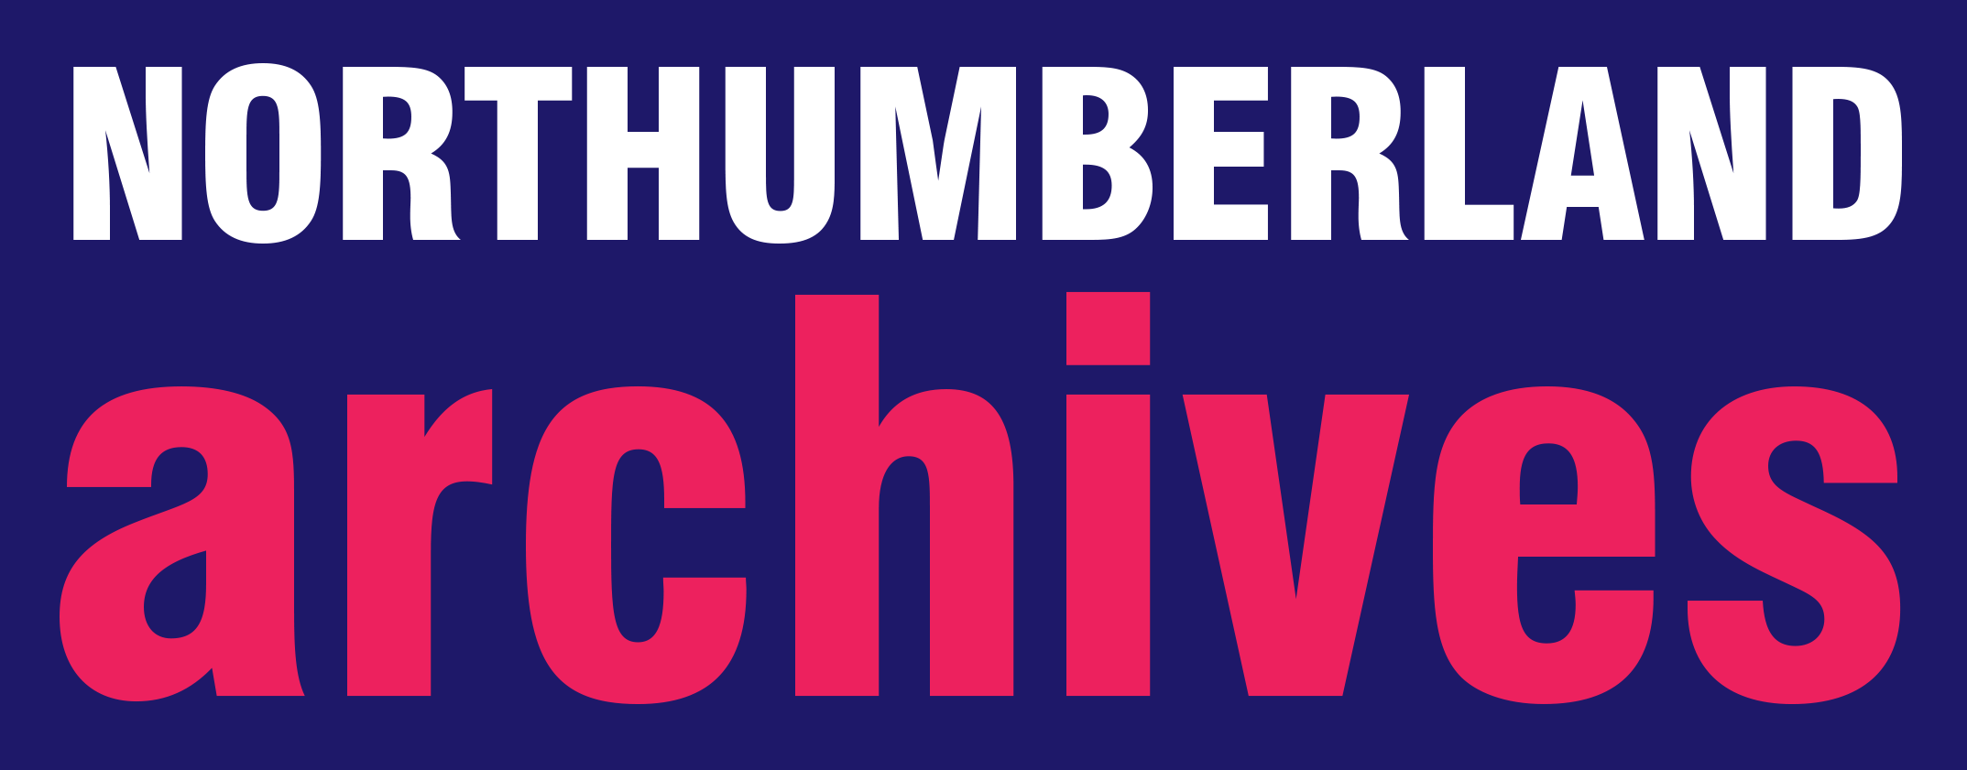

Animation

Slide 2
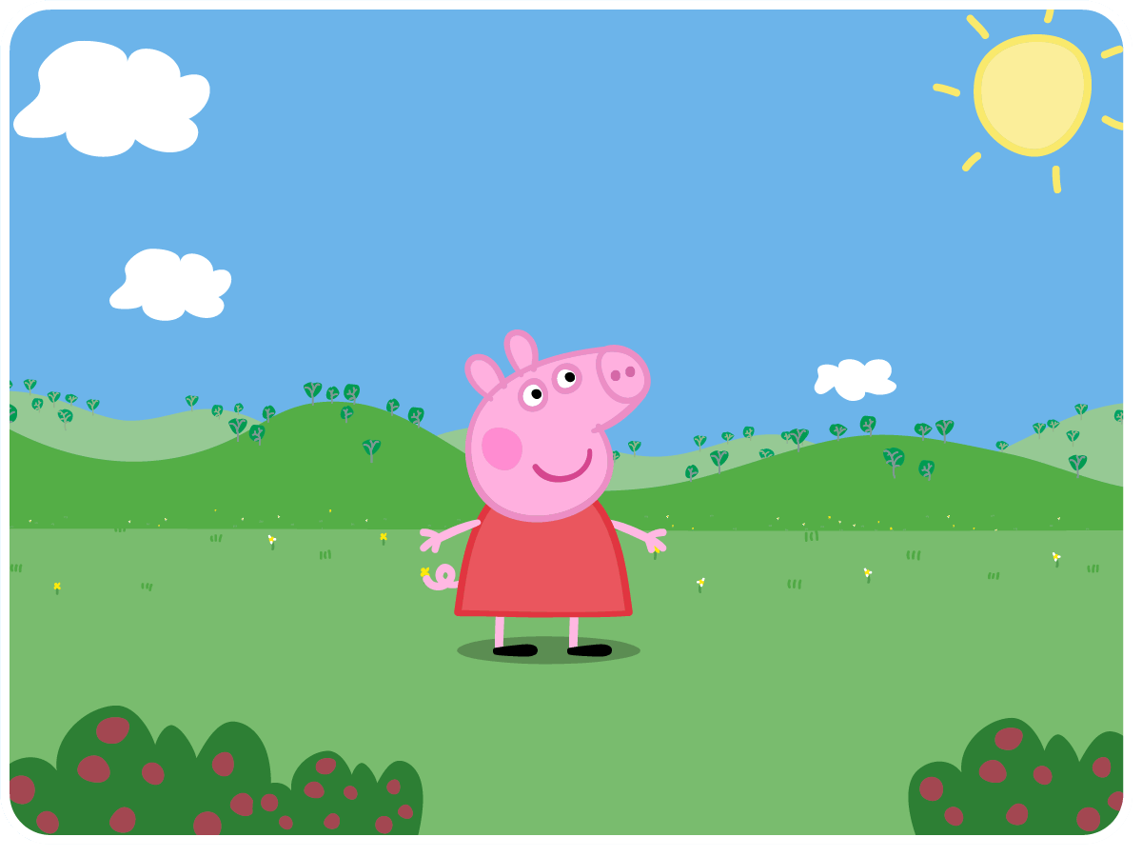
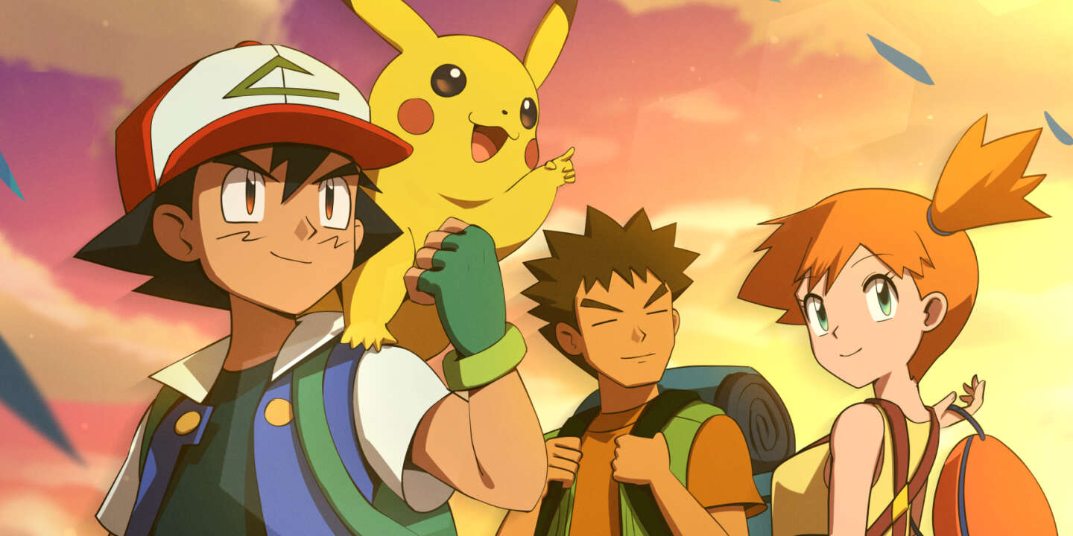
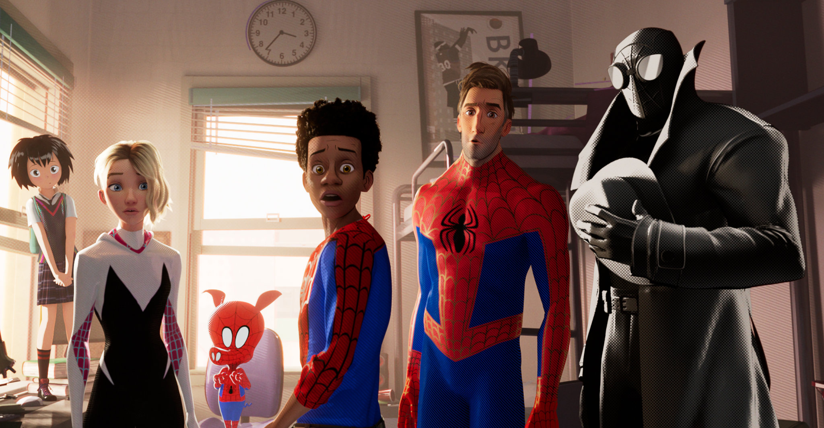
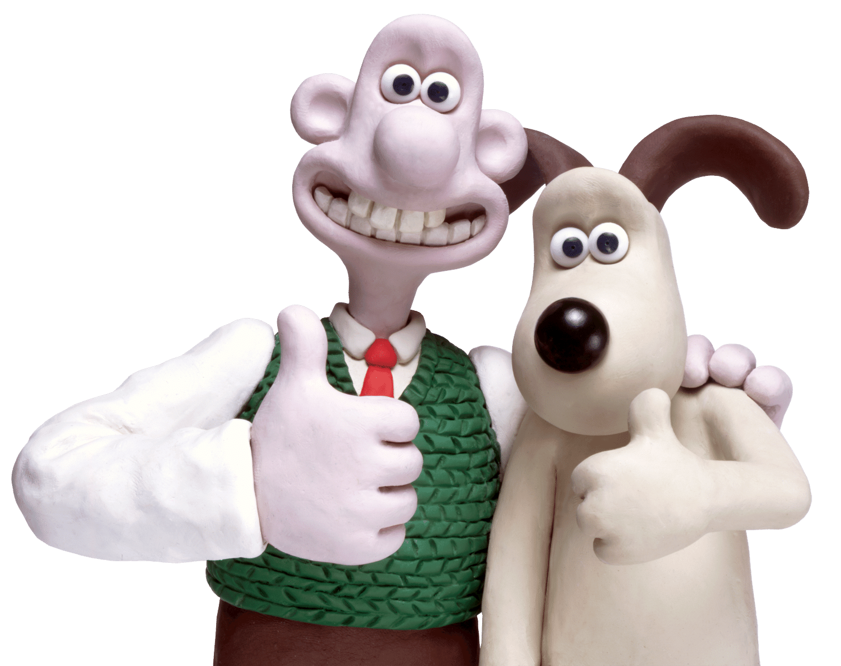
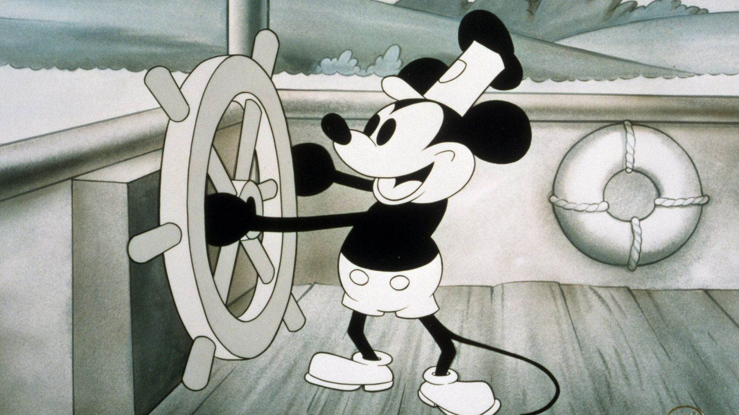
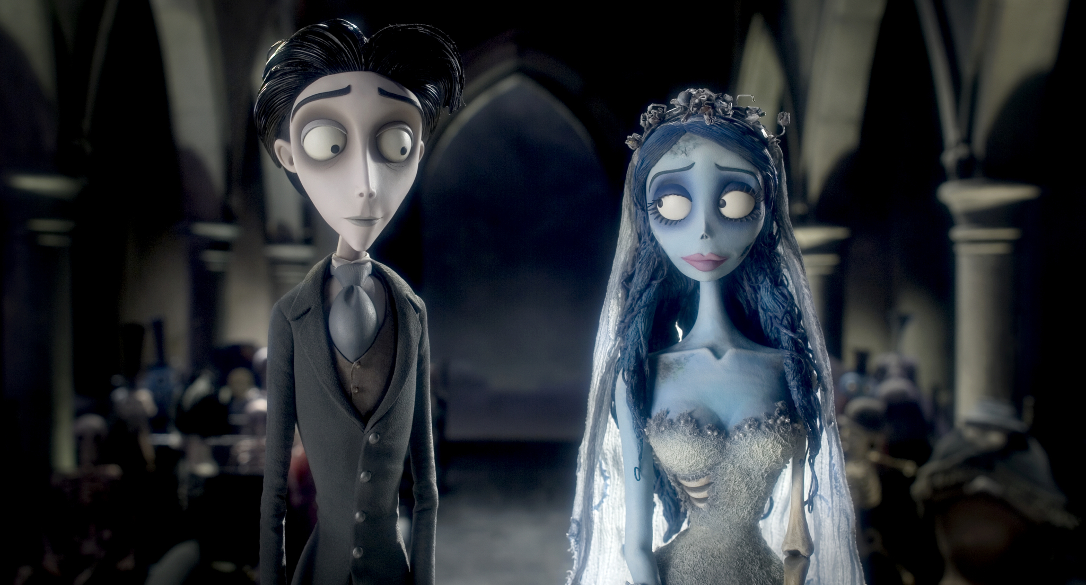
What is animation?
The art of making stationary images or objects look as if they are moving.

Slide 3
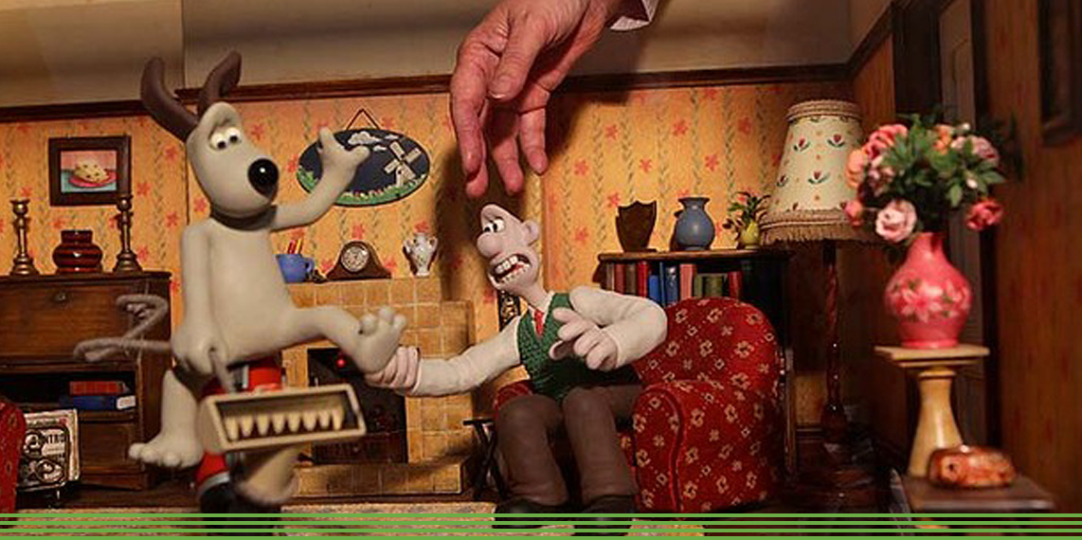
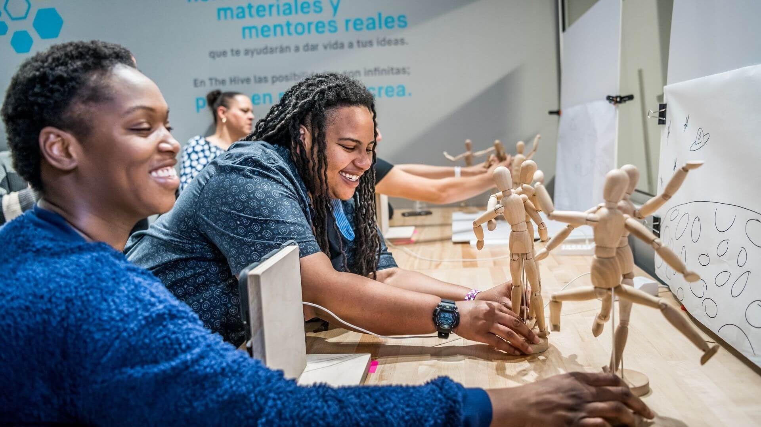
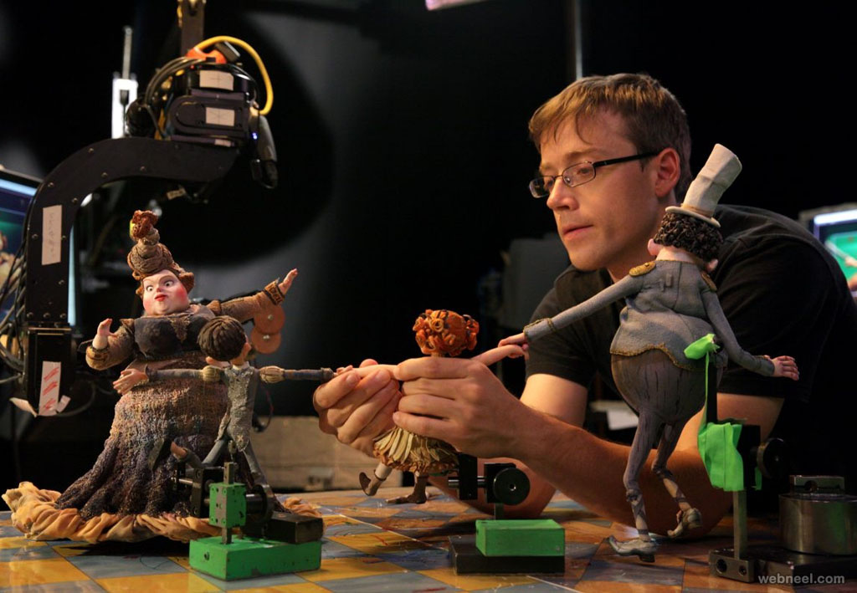
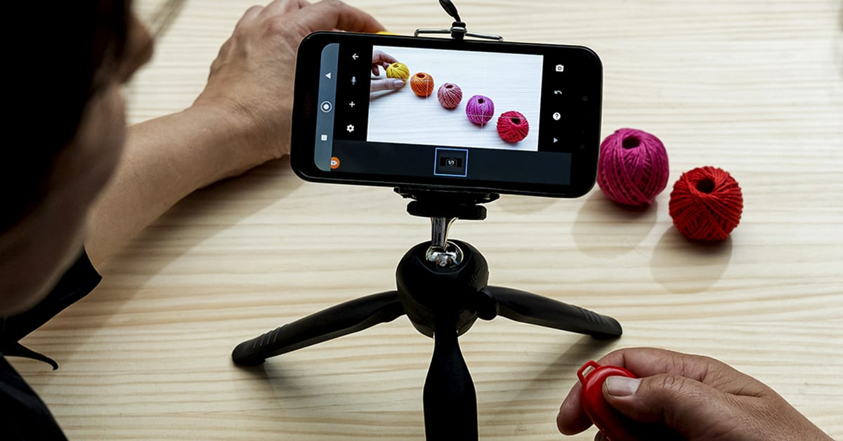
What is stop motion animation?
Stop motion is an animation technique that uses small movements and lots of photographs to give the impression of movement in a story.

Slide 4
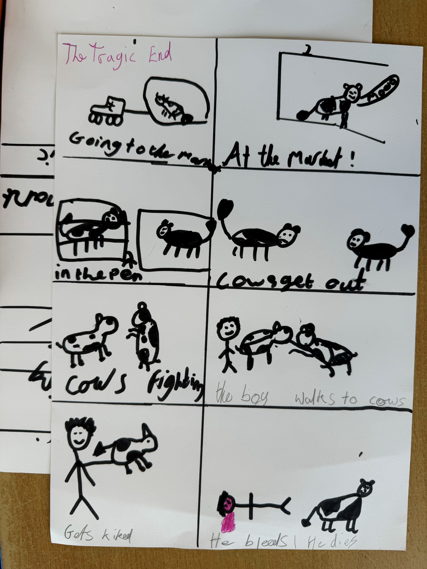
Getting started
1. In groups, come up with your idea – e.g. build your own manor, court room and consequences, marketplace scene.
2. Make a storyboard for your idea – what will happen, where will it take place, who are your characters, what backgrounds or props will you need?
3. Share your ideas with the class.

Slide 5
Allocate Roles
Directors – group leaders, oversee the creative vision of the film.
Camera operators – photograph each scene, make sure the camera is still and lined up correctly for each frame.
Scene/background designers – create the backgrounds, make sure the correct backgrounds are used for each scene.
Character designers/animators – create the characters, move them each frame.
Script supervisors – plan what is needed for each scene, check each set-up to make sure everything needed is included.

Slide 6
Go!
Create your animations!

Slide 7
Celebrate your work
Show and Tell
Share with Northumberland Archives

