Slide 1

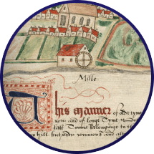


Manorial Courts & Customs

Slide 2
Manorial Courts
Manors had right to hold their own courts.
Manors had two types of court:
Court Baron – This court was held by the Lord/Lady of the Manor, and focused on enforcing the manorial customs.
Court Leet – This court dealt with offences which went beyond manorial customs, usually focusing on minor criminal offences.

Slide 3
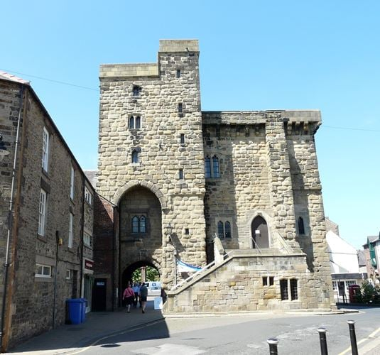
Example – Manor of Hexham
The Moot Hall in Hexham was used as the Manor Court
Built 1397
Used as manor courtroom until 1838

Slide 4
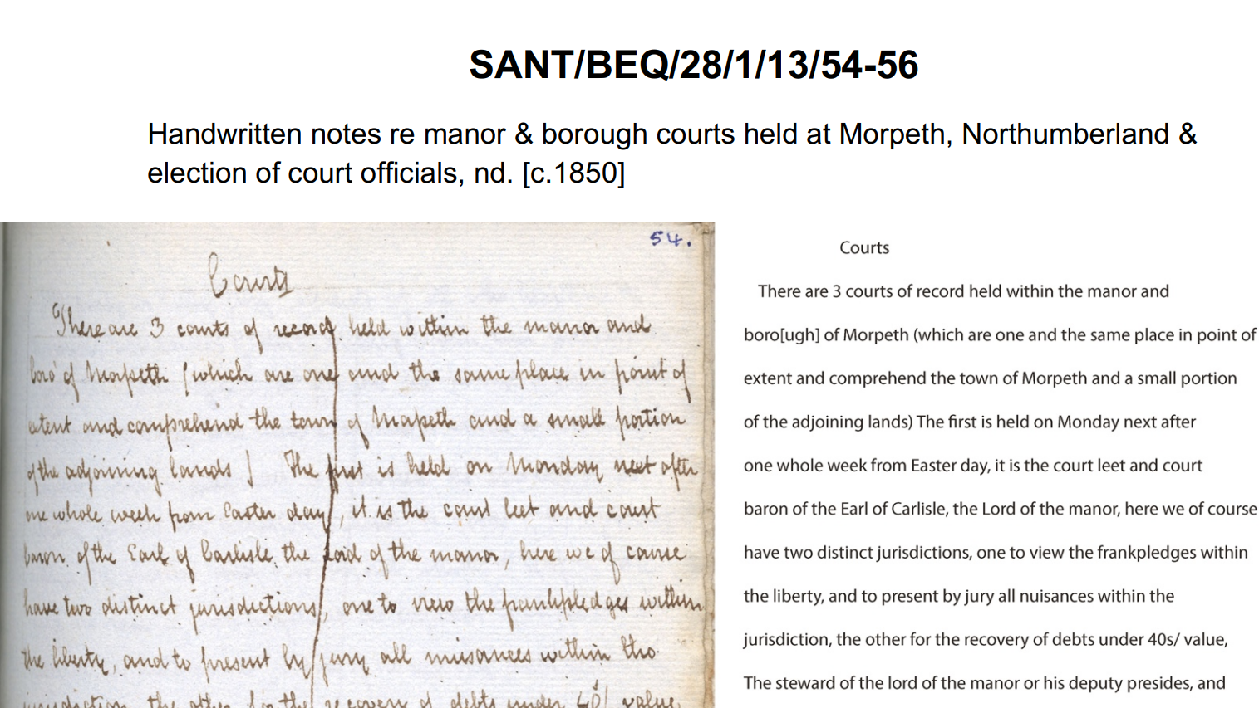
How did Manorial Courts Operate?

Slide 5
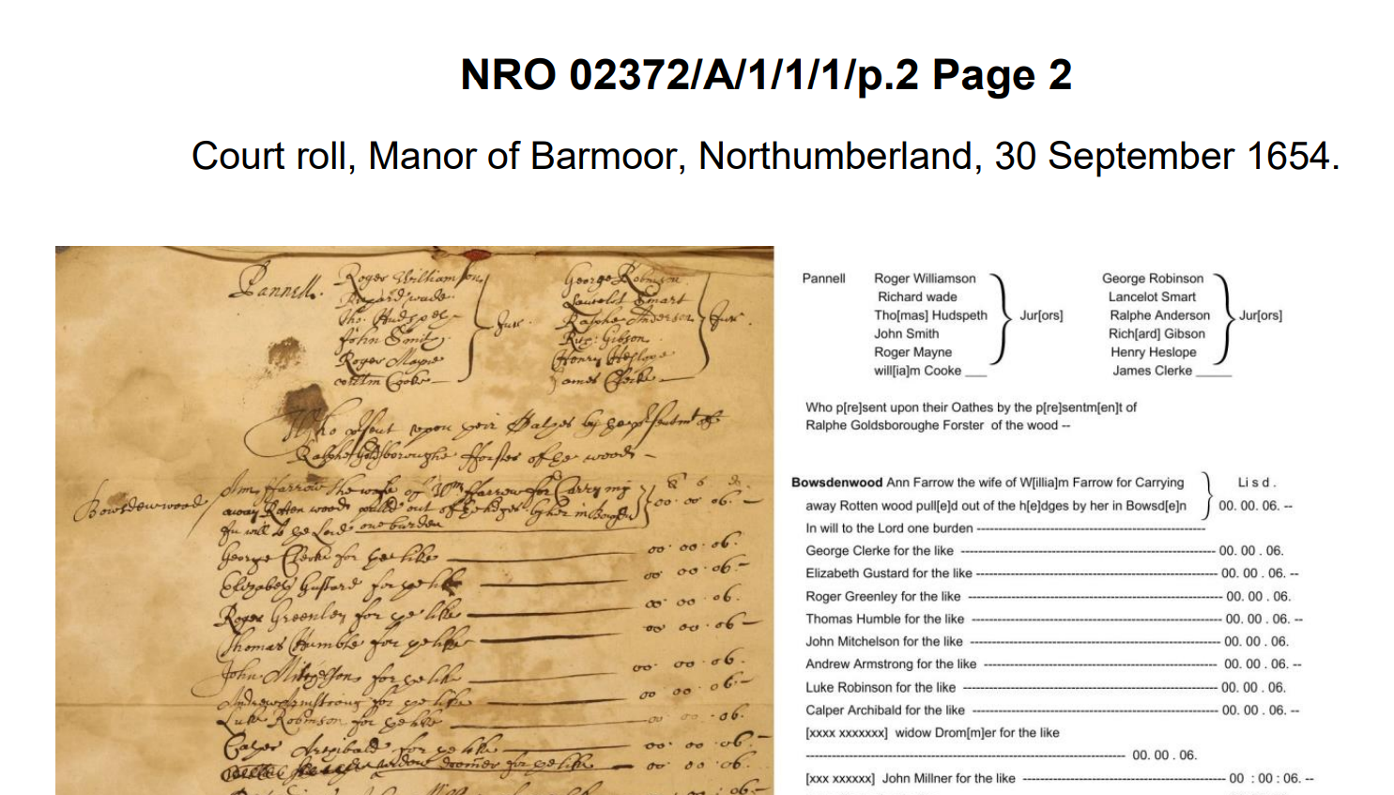
Why were people presented at manorial court?

Slide 6
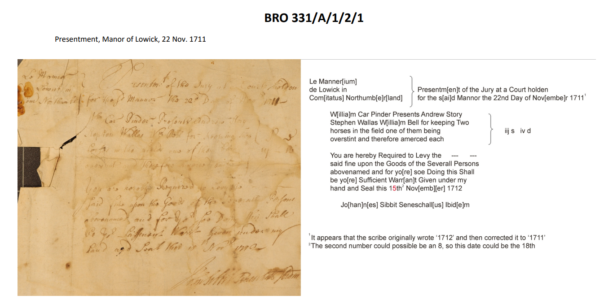
Manorial Customs - Lowick

Slide 7
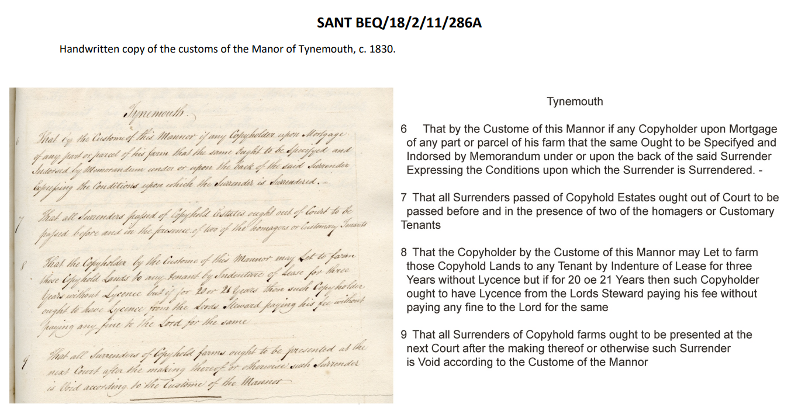
Manorial Customs - Tynemouth

