Slide 1




Oral History

Slide 2

What is an Oral History?
30 Seconds – come up with a definition
A sound recording of someone talking about their personal experience of past events.

Slide 3

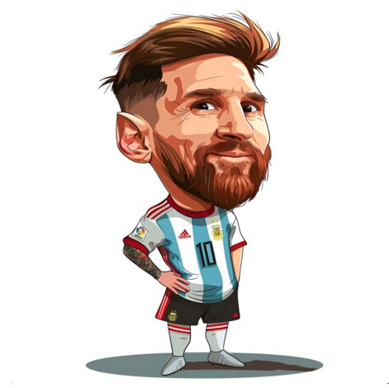

Oral History
Who?
Celebrity
Everyday person

Slide 4

Oral History Example
How many people are speaking? Is there anyone else there?
Can you hear the names of any places that you know? Are there any words that you don’t know?
What is described in this interview?

Slide 5





Oral History
Oral History Skills
Please…
Thank you…
Blah, blah, blah

